Slide 1
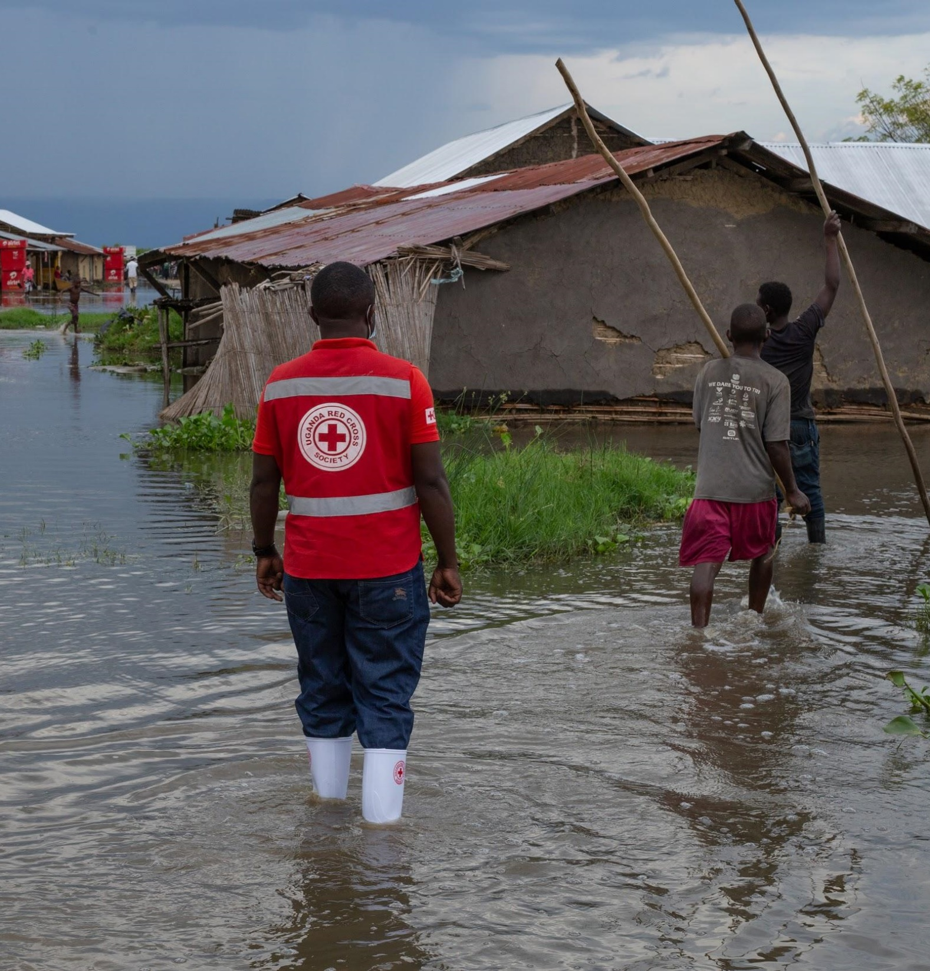
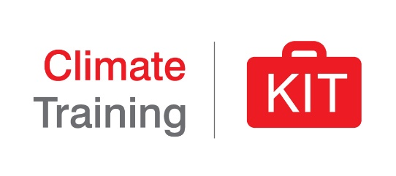
Climate change
and health
Pixabay
Notes:
Note: The ‘speaker notes to this presentation are comprehensive and provide background information to support facilitator preparation and/or reply to questions from trainees/trainers. It is not the intention that all information is presented in every session - so as facilitator, you could build a relevant story line depending on the audience and duration of the session. The intention is that the facilitators/trainers also adapt the pitch of the presentation to suit the audience and pre-existing technical knowledge.
This presentation is summarizing the broad health implication of climate change, while a separate presenation in this module focuses more on specific WASH aspects.
Talking points:
- The humanitarian mission of the Red Cross Red Crescent is to improve the lives of vulnerable people, reduce impacts and help them thrive. Health plays a central role in reducing vulnerabilities and facilitating recovery.
- National Societies around the world are already grappling with emerging health emergencies which are very likely to be linked in some part to change and variability.
- Proactive health risk reduction strategies and programmes can be taken to reduce impacts in vulnerable population subgroups.
NOTE: In this presentation, all photos without acknowledgments are credited to the Climate Centre depicted as "Photo: Climate Centre"

Slide 2
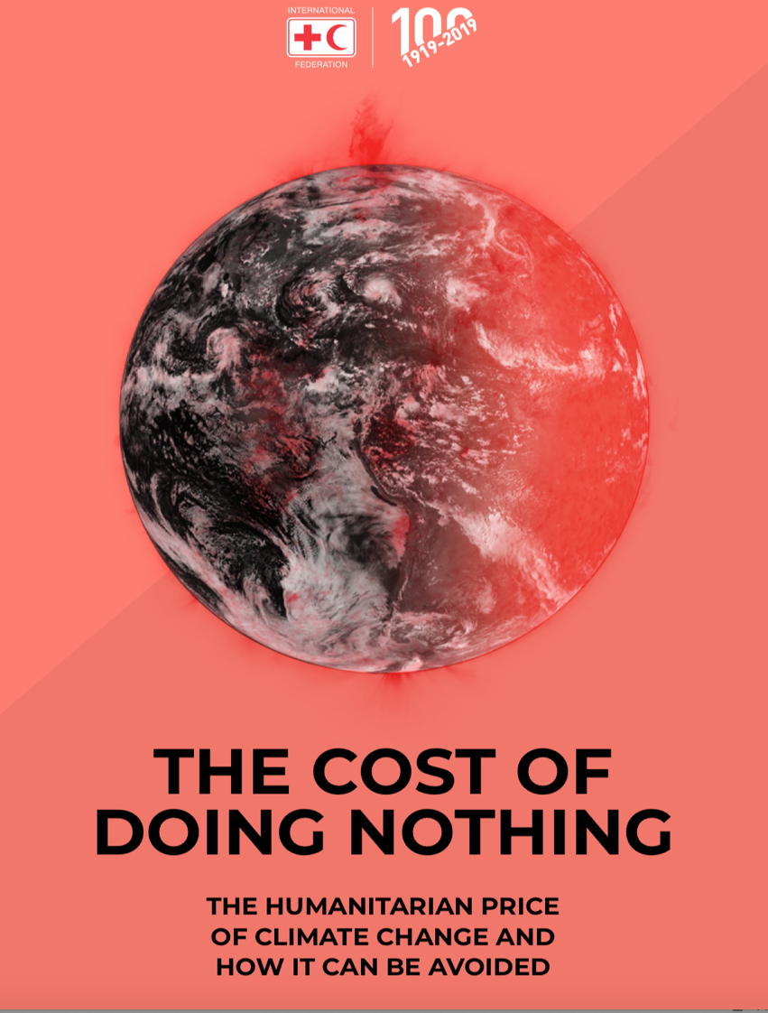
200 million people dependent of humanitarian assistance per year as a result of climate change by 2050, compared by 108 million today
20 billion USD needed annually by 2030
We still have a chance to act!
Notes:
Interaction: Can you guess how many people in the world are in need of humanitarian assistance currently? What are the projections for 2050 as a consequence of climate change related extreme weather?
Key talking points:
- The Cost of Doing Nothing – published by the IFRC and launched at the Climate Action Summit in NY in September 2019 – estimates that the number of people in need of humanitarian assistance in 2050 as a result of storms, droughts and floods could climb beyond 200 million annually compared to an estimated 108 million today = Doubling.
- It suggests that this doubling up of the need would come at a price, with climate-related humanitarian costs ballooning to US$ 20 billion per year by 2030 in the most pessimistic scenario. With no action, costs are likely to be higher.
- These findings confirm the current impacts of climate change, and will continue to have, on some of the world’s most vulnerable and marginalized people.
- The report highlights the chance to do something given the accelerated rate of change observed. Now is the time to take urgent action.
- By investing in climate mitigation, adaptation and disaster risk reduction, including through efforts to improve early warning and anticipatory humanitarian action, the world can avoid part of the impacts and costs.
- Determined and ambitious action NOW that prioritizes inclusive, climate-smart development could reduce the number of people in need of international humanitarian assistance annually to as low as 68 million by 2030, and potentially even further to 10 million by 2050 – a decrease of 90 per cent compared to today.
Additional information for the moderator:
- The Cost of Doing Nothing builds on the work and methodology of the World Bank’s Shock Waves report, and draws on data from the UN, the EM-DAT International Disaster Database as well as IFRC’s own disaster statistics.
- The Report presents potential consequences should the global community fail to step up ambition to address the rising risks of changing climate. It also highlights potential positive outcomes of action to strengthen resilience, adapt and address the current climate related health crises.
- The data in this presentation has been updated with findings from the latest IPCC WGII report from 2022.

Slide 3
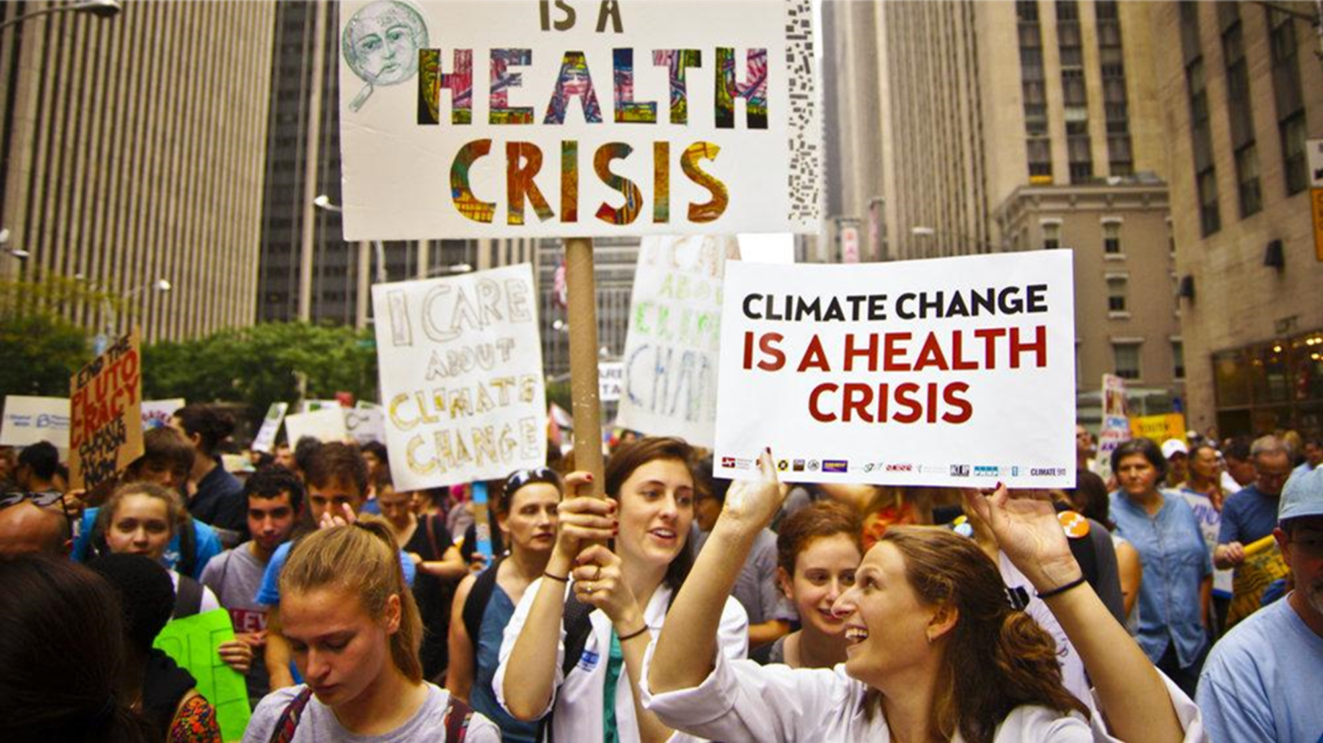
(Photo: Joe Brusky/flickr/cc)
Notes:
Interaction:
Have you seen a picture of a polar bear on a melting iceberg as an illustration of climate change?
Have you seen signs with reference to health during any climate protests? (“Climate change is a health crisis”)?
Key talking points:
- Many people still think of climate change as an environmental issue, that might threaten polar bears but do not consider it may affect human health.
- However, the WHO has stated that "climate change is already impacting human health and is one of the most critical health crisis of our time" (WHO website 2019). It needs to be addressed at scale - urgently.
- There is ample scientific evidence that climate change is already contributing to excess mortality and morbidity at the global level.
- Yet, only 0.5% of multilateral climate finance has funded health projects (WHO 2018).
- We need to advocate for a shift in the narrative and raise awareness that climate change is indeed a health crisis.
Additional information for the moderator:
- There is increasing certainty that climate related risks for health are already rising. However there is also high uncertainty about when and where these changes will occur and have an impact in the future.
- According to the Lancet 2019 ‘Countdown report on health and climate change’: "Present day changes in heat waves, labour capacity, vector-borne disease, and food security provide early warning of the compounded and overwhelming impact on public health that are expected if temperatures continue to rise."
- Trends in climate change impacts, exposures, and vulnerabilities show an unacceptably high level of risk for the current and future health of populations across the world.
Photo: Joe Brusky https://www.flickr.com/photos/40969298@N05/15318842856/

Slide 4
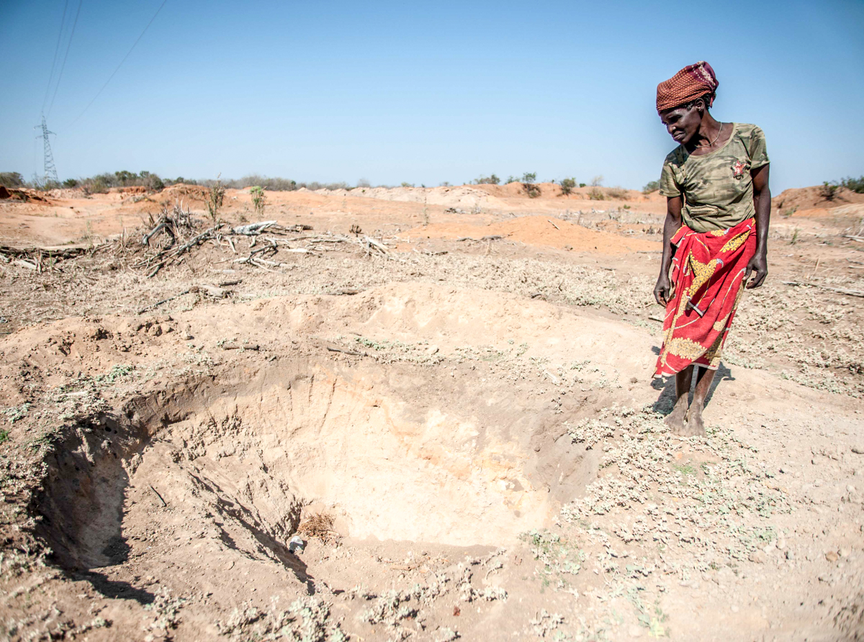
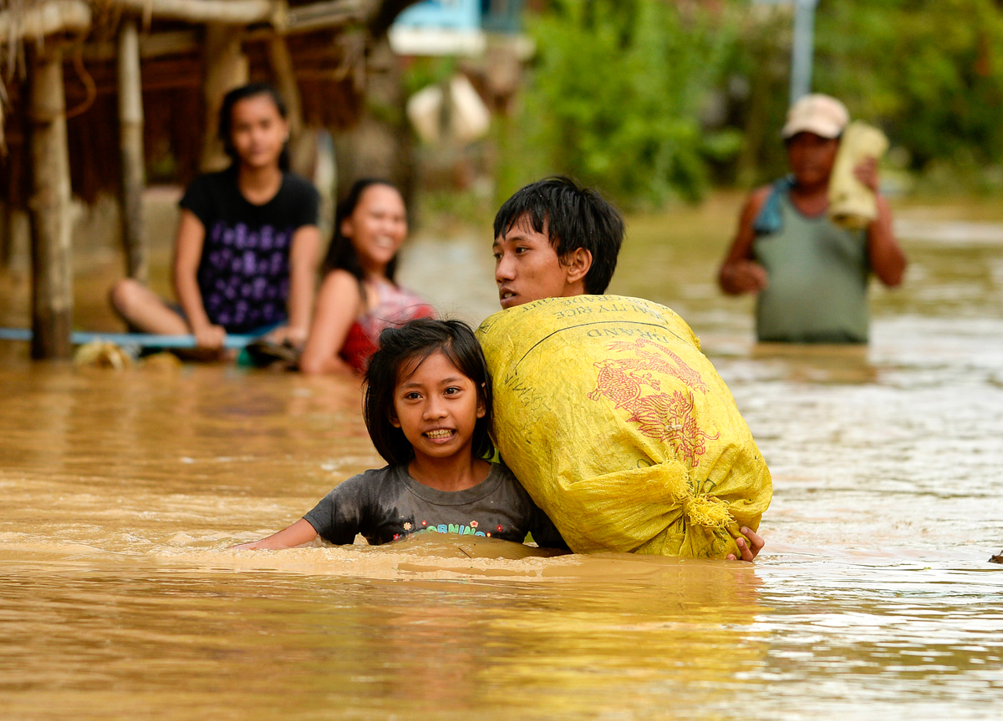
Changing patterns
Photo: IFRC/A.M. d'Unienville
Photo: IFRC/N. Celis
Notes:
4
Interaction: Have you experienced/ witnessed impacts of climate change in the environment? If yes, briefly describe the nature of impacts, where and how?
Key talking points:
Climate change will trigger changes in averages as well as variability of weather parameters, increases in frequency and intensity of extreme events, increase temperatures and therefore associated heat waves, sea level rise, melting glaciers, shifts in seasons amongst others.
Challenges are accelerating – such as for instance sea level rise – with impacts in coastal areas where large areas may end up being uninhabitable or salinated (for example in Bangladesh)
Evolving patterns with high uncertainty in impacts will create greater challenges for humanitarian organizations to sense, prepare and respond.
“Changing patterns” will affect severity of events and potentially affect new areas (for example a cyclone/typhoon/hurricane making landfall in new areas, vector-borne diseases spreading to new areas e.g. Highlands, and emerging or re-emerging pathogens e.g. Dengue and other infectious diseases).
It might also mean that seasons are shifting, without clear ‘traditional’ warning signs, which means that populations will have to deal with increased uncertainty (for healthcare providers, but also for farmers, herders, water providers, etc.).
In summary, risks faced by communities are dynamic and constantly evolving (spatially/location wise and temporally/time wise) and traditional risk management methods might no longer be as adequate as before.

Slide 5
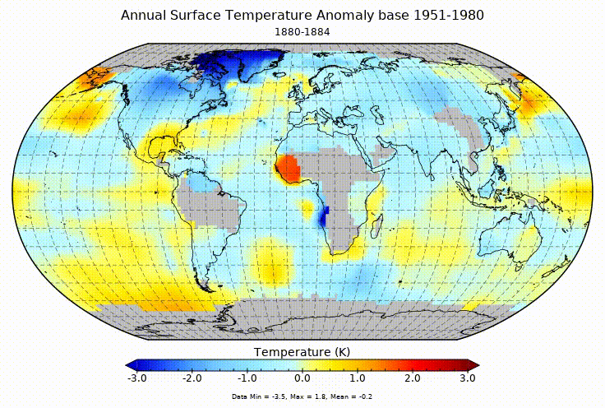
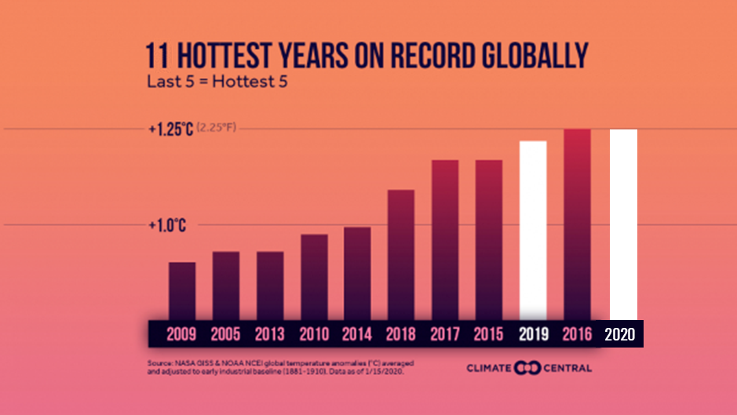
Scientists confirm that the problems are global
Source: NASA
Notes:
Interaction: What do we see here? can anyone summarise the graphic?
It is an illustration of the annual surface temperature anomaly based between 1951 and 2019, the blue color shows annual temperature below average, and the red color shows annual temperatures above average.
Key talking points:
One of the most vital indications of climate change is the steady increase in average global temperature over the past century.
The animation (from NASA) shows the 5-year mean temperature 1880-2017 – seen in relation to a “baseline" period 1951-1980.
Out of the hottest years recorded globally, 9 occurred between 2010-20, with 2016 and 2020 holding the highest records ever.
In 2020, 44th consecutive year that global temperature was above average
It is important to know that climate change is a global issue, but it is experienced very differently at the local level. For more information please refer to the 1a. Science and Impacts Presentation included in the CKT.
Last 11 hottest years: Data from NOAA/National Center for Environmental Information. Graphic from Climate Central.

Slide 6
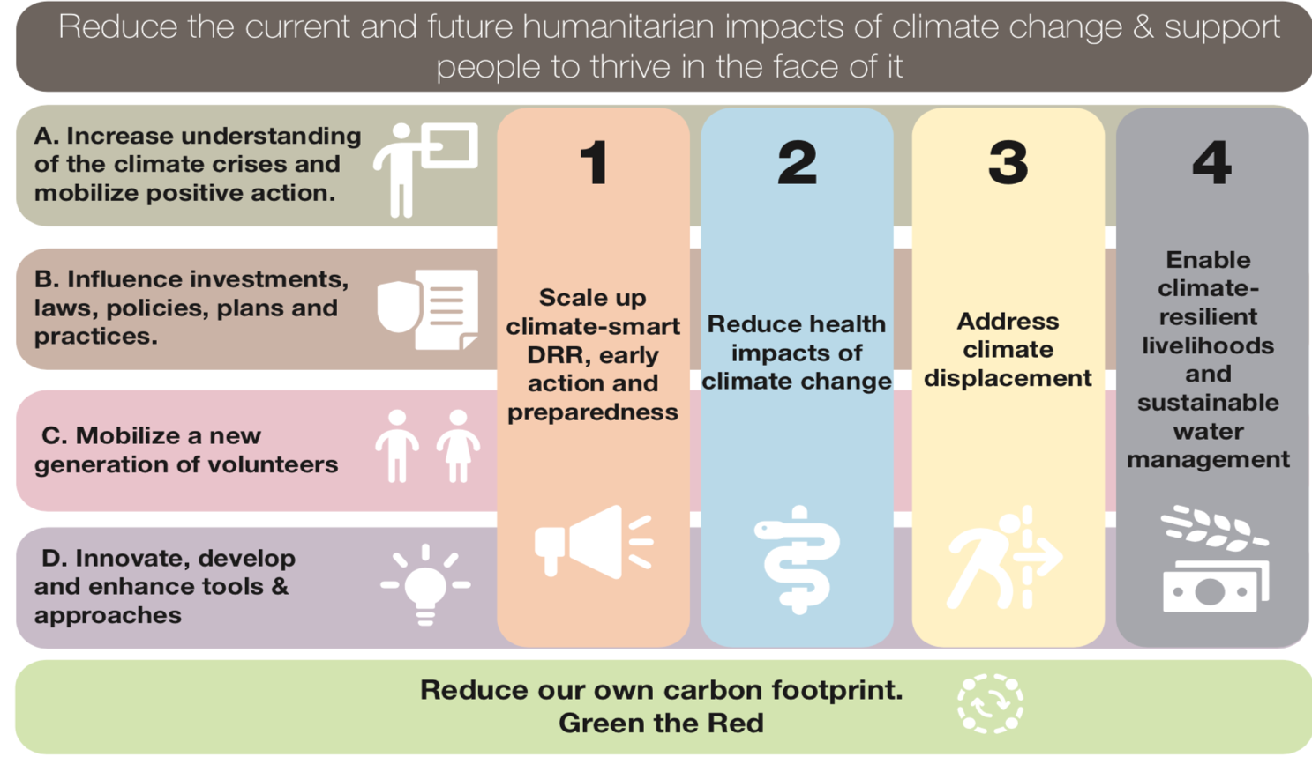
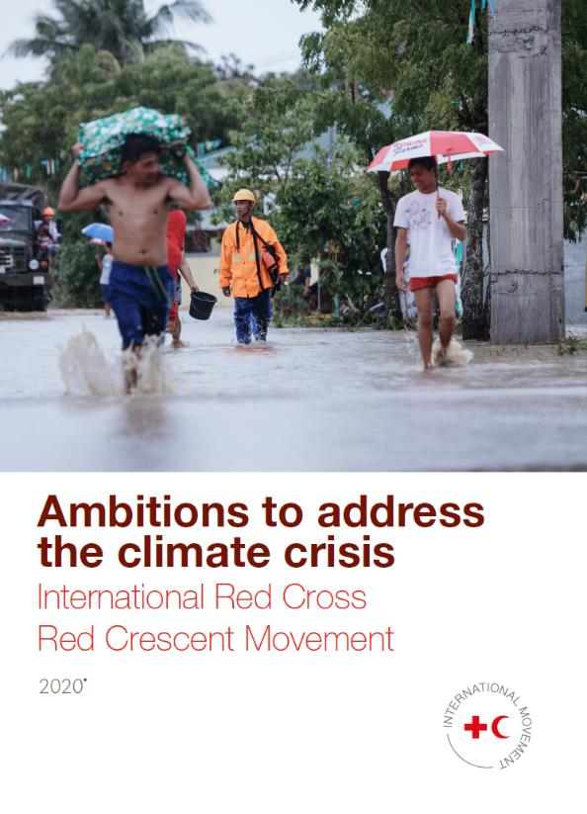
The Red Cross Red Crescent’s Ambitions
adapt in the face of it
livelihoods, infrastructure and sustainable water management
C. Strengthen our volunteer base to reduce the impacts of the climate crisis
Notes:
Interaction: Have you heard/read the IFRC “Ambitions to address the climate crisis” document?
Key talking points:
-At the IFRC General Assembly 2019, climate crisis was identified as one of the top global humanitarian challenges and 'Ambitions to address the climate crisis’ set out in the associated document - summarized in the slide –
-IFRC Strategy 2030 identifies 'Climate and environmental crisis’ as the top of five global challenges. Others being Migration, Growing Inequalities, Increasing Conflicts and Demographic Changes
-Historically the Red Cross Red Crescent Movement has been been focusing most of its climate change action towards disaster risk reduction.
-Health is one of the four main pillars of its strategy to address the humanitarian impacts of climate change and suport people to adapt and thrive in the face of it (See Graphic on the slide). It aims to systematically integrate climate risk management across all health programmes and anticipate the health-related consequences of climate change and environmental degradation, focusing on people experiencing increased exposure and vulnerability.
- As you can see, each pillar is supported by different types of actions: “increase understanding of the climate crisis and mobilize positive action”, “influence investments, laws, policies, plans and practices”, “strengthen our preparedness expertise and volunteer base to reduce the impacts of the climate crisis” and “innovate, develop and enhance tools & approaches”.
- The “Green response” component should also be considered in all the Red Cross / Red Crescent Movement to reduce own carbon footprint and leadingby example.
Additional information for the facilitator:
- Documents mentioned above (Ambitions and Framework 2030) build on the IFRC Framework for Climate Action towards 2020 that was designed to support both IFRC and National Society planning processes and dialogue with partners and governments for advocacy work.

Slide 7
What this module will cover
LEARNING OBJECTIVES: By the end of this module, you should be able to:
Understand the public health risks associated with climate change
Describe direct and indirect helath impacts of climate change
Identify interventions to reduce health climate change impacts
Identify tools and resources on climate change and health
STRUCTURE
PART I – Health risks associated with climate change
PART II – Interventions to reduce health risk associated and climate change
PART III – Tools and resources

Slide 8
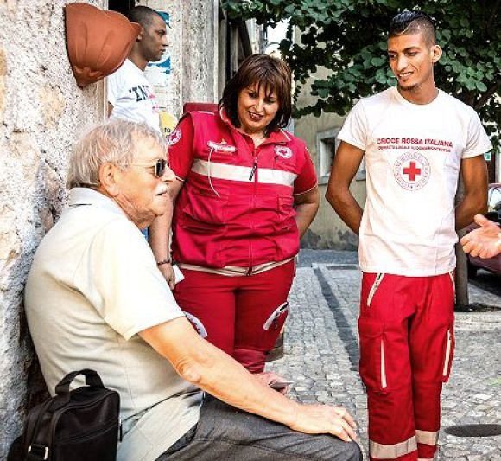
Part I What are the health risks associated climate change?
Photo: Italian Red Cross/IFRC
Notes:
Question: What do you think are the main risks to and the health impacts of climate change?

Slide 9
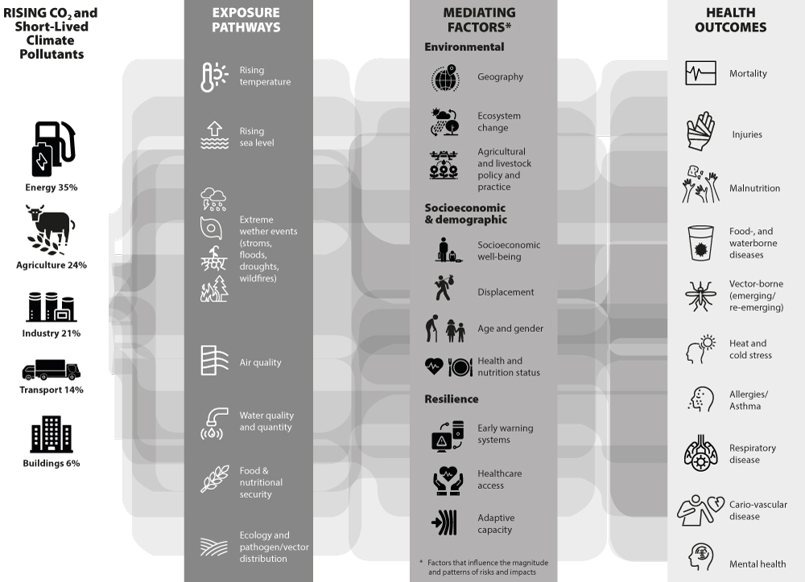
Notes:
Let’s start with a general overview – note it is an animated slide, so view in presentaion mode to see the entire picture.
Climate change is a very complex phenomenon that has direct and indirect impacts on the environment and on health.
Direct health impacts include heatwaves, storms, floods, drought… They can have direct consequences such as death, injuries, heat stress, etc.
Indirect effects include water scarcity, food contamination, air pollution, ecological change… They can have indirect health consequences such as malnutrition, infectious diseases, heart and lung diseases, mental health disorders.

Slide 10
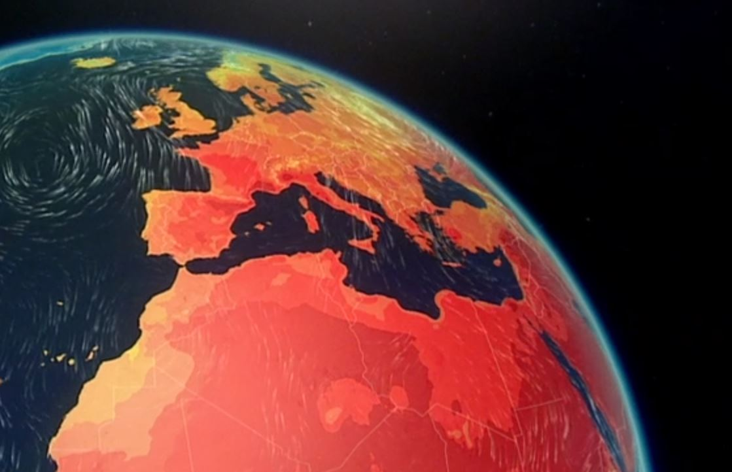
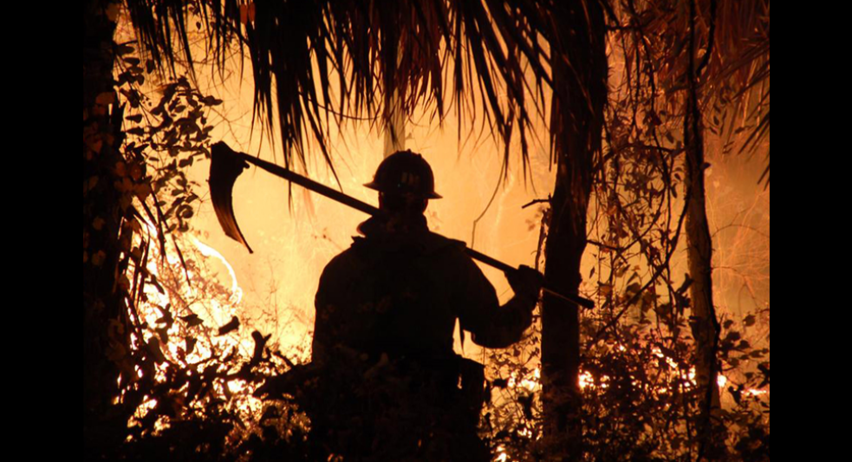
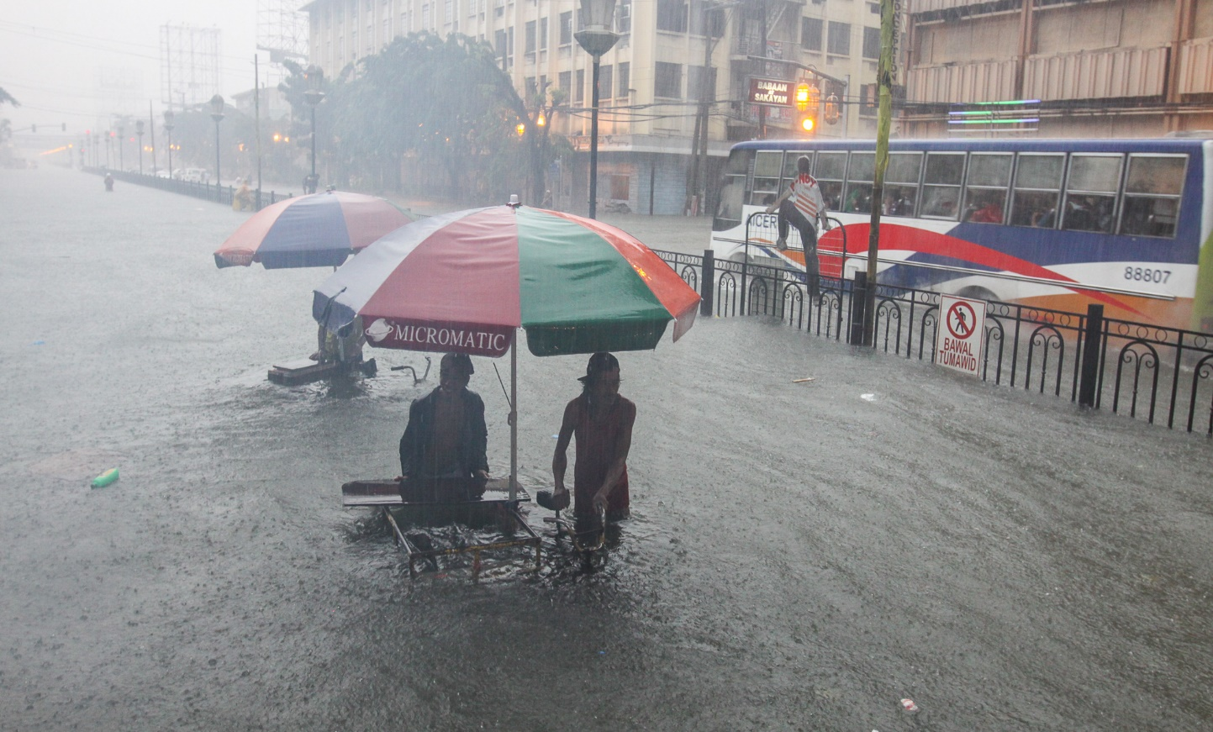
Death and injury
Source: BBC News
Photo: USAF
Photo: M. Godinez/PRC
Photo: K. Falk / Danish Red Cross
Notes:
Key talking points:
- Global warming is an increase in the average temperature of our planet and is just one event caused by climate change. Other climate change events include changes in rainfall patterns and in the frequency or intensity of extreme weather events like hurricanes, floods, heatwaves, drought, etc.
- Since 1900 more than 11 million people have died as a consequence of drought and more than two billion have been affected by drought, more than any other physical hazard.
- While droughts and floods were historically very deadly, the number of deaths associated with those events is now fairly low.
- However, climate events and changing patterns also still have a very strong impact on the natural and socio-economic systems that we evolve in, which causes some indirect health consequences as we just saw in the preceding slide. We will explore those indirect consequences throughout the presentation.

Slide 11
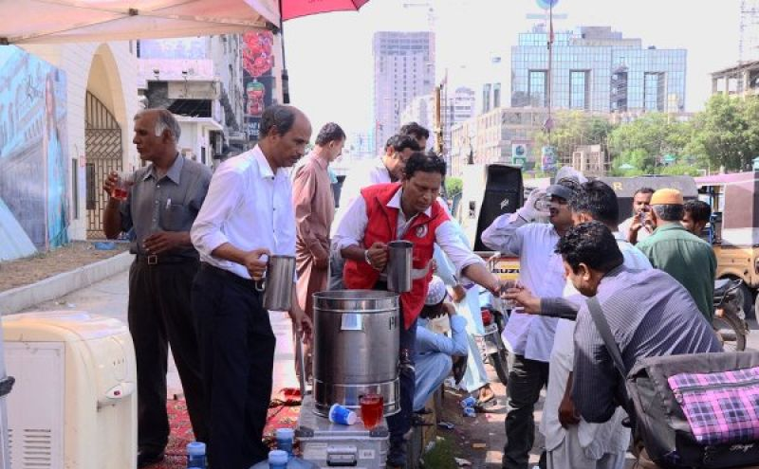
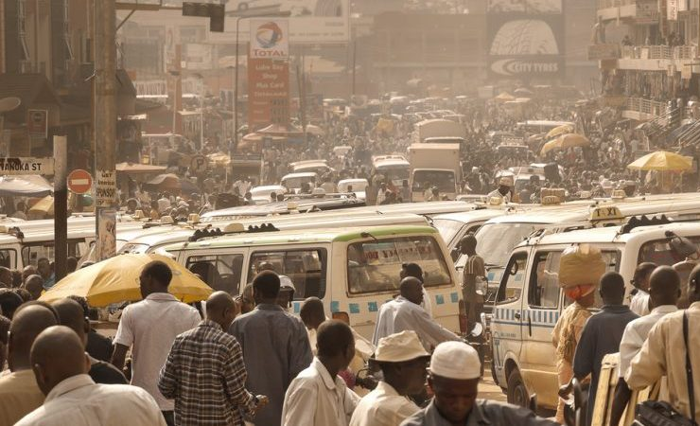
Heat-stress and temperature related mortality
Photo: Pakistan Red Crescent Society
Photo: Weesam2010/Flickr
Notes:
Interaction: How many of us have experienced a heatwave? When was it? Can you describe your experience?
Talking points:
- Climate change is expected to increase average temperatures as well as the number and intensity of heatwaves.
- Heat is deadly when it is experienced over long periods of time: our bodies are able to adapt to high temperatures for short periods of time. But when we're exposed to high heat and unable to cool down especially at nighttime, that’s when the mortality starts rising up. That’s why heatwaves are more deadly when temperatures stay hot during the night, and also why the increase in mortality only appears after delay of a couple of days.
- In addition, the impact of heat is deadlier when it is combined with humidity. When it is humid, it feels hotter, and the body is not able to cool itself as well.
The impact of heatwaves is also greater in cities due to the « heat island effect »: the heat is absorbed during the day and re-radiated during the night by building materials such as concrete, which increases heat-stress on human bodies. Cities also lack built environment features that can reduce the burden of heat including tree cover and access to water.
In addition to increased mortality, extreme heat has been associated with adverse birth outcomes including higher rates of preterm birth, low birthweight, and still birth.
Heatwaves are expected to become more severe and more frequent due to climate change. However, due a higher variation in temperatures, climate change might also cause cold waves. Heat and cold waves have direct health consequences such as temperature-related mortality, heat stress or hypothermia.
Estimates show that 37% of heat-related deaths are due to climate change
Temperature related health impacts are preventable, we will address some possible interventions in the second part of the presentation.
Additional information for the moderator:
There is no universally accepted definition of heatwaves. Heatwaves are understood to be periods of unusually hot and dry or hot and humid weather, with a duration of at least two–three days, usually with a noticeable impact on humans and natural systems. Heatwaves are defined relative to a location’s climate: the same meteorological conditions can constitute a heatwave in one place but not in another. Day and night-time conditions are important for understanding the health effects of heatwaves.
The 2003 European heatwave killed more than 70,000 people, the heatwave in 2010 in Russia have reported 56.000 excess deaths and the 2015 heatwave in India reportedly killed over 2,500 people. These are likely underestimated since deaths from heatwaves are often not attributed to the heatwave, but to illnesses that are made worse by heat, such as heart disease.
More intense and frequent heatwaves are already occurring in many parts of the world. Their frequency and intensity are expected to rise globally due to climate change.
Seventeen of the 18 warmest years of global temperature records have occurred since 2001. However, deaths from heatwaves are not inevitable and, in fact, they can be greatly reduced through the implementation of relatively simple and cost-effective actions. In August 2003, over 18,000 heat-related deaths occurred in France as temperatures of more than 40°C were recorded in the worst heatwave seen in decades. Temperatures at night did not cool down as they typically do, and people living in France did not have electric fans or air conditioning to cope with the persistent heat.
Heat extremes are increasing with higher day and night temperatures, almost all around the globe. Heatwaves have major directly/indirectly impact on human health.
Days that are hotter than the average seasonal temperature in the summer or colder than the average seasonal temperature in the winter cause increased levels of illness and death by compromising the body’s ability to regulate its temperature or by inducing direct or indirect health complications. Climate change is expected to increase average temperatures as well as the number and intensity of heatwaves. Heatwaves are associated with increased mortality in the short term, especially among populations who are not adapted to extremely hot weather.
Photo: Weesam2010/Flickr - https://www.flickr.com/photos/weesam/5758662612/in/album-72157625690670559/

Slide 12
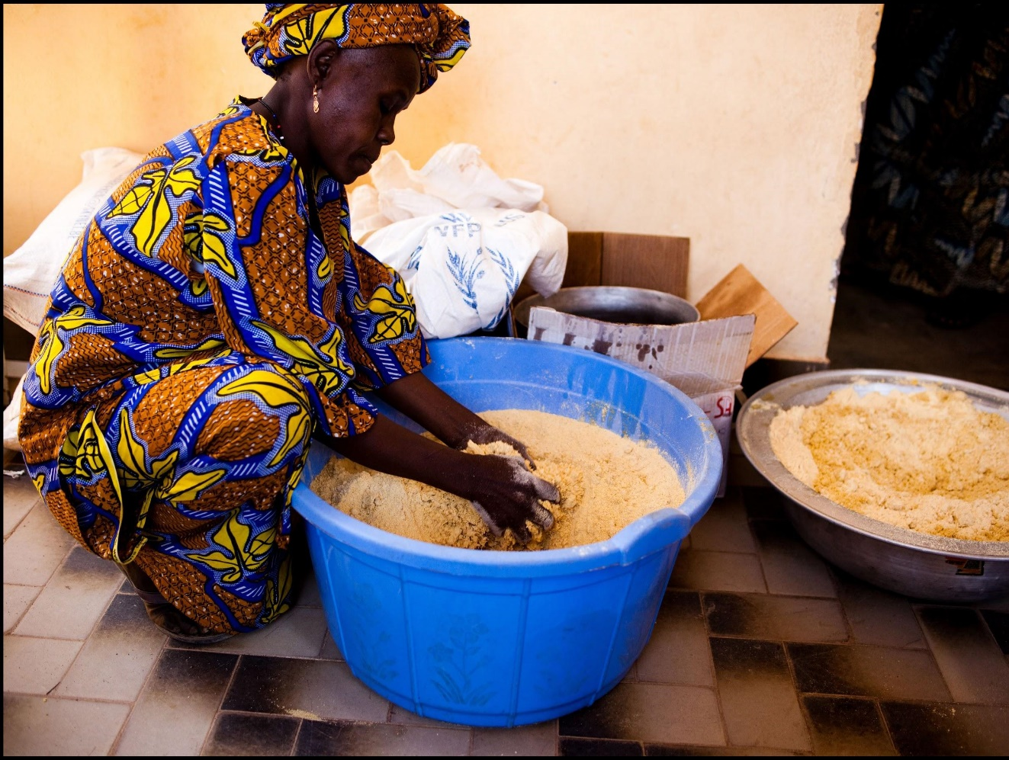
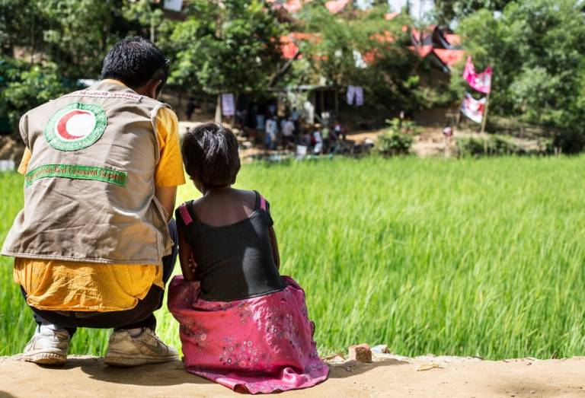
Malnutrition
Photo: J. Goldstein/IFRC
Photo: American Red Cross
Notes:
Interaction: Do you think climate change affects food and nutritional security? If yes, how?
Key talking points:
Food security has four dimensions- availability, access (physical and economic), stability and utilization (disease status such as malaria or diarroheal disease that reduce nutrient absorption capacity)
Droughts increase the risk of food shortages and malnutrition and diseases spread by contaminated food and water.
Climate change affects global food production (and therefore availability/access) through damages caused by extreme weather events such as foods, droughts and increase in crop plant diseases.
Reduction in yeilds and wastage within food systems drive the food prices affecting economic access.
Climate Change also affects the quality of food available by reducing nurient content (e.g. proteins, zinc and iron) of staple food crops- worsening the hidden hunger crises (micronutrient deficiencies like anemia)
Underlying causes of nutrition include socio-economic and demograohic status, location etc. (See UNICEF framework for more details on underlying causes)
Malnutrition increases the susceptibility to infectious diseases- An omni-vicious cycle!

Slide 13
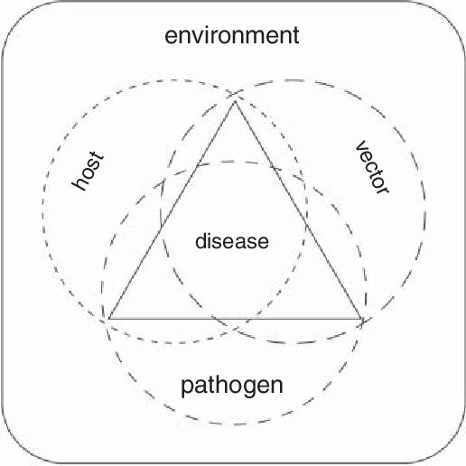
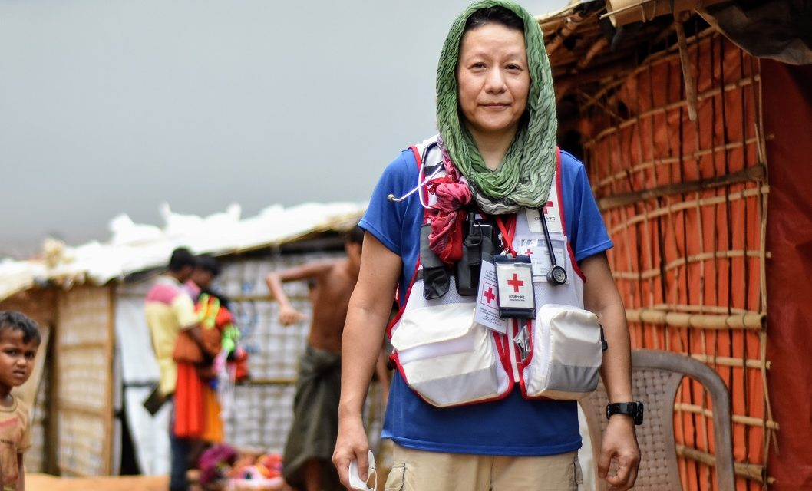
Infectious diseases
Photos by: Lynette Nyman/IFRC and A.J Ghani
Source: Trebicki & Finlay (2018): Pests and diseases under climate change; its threat to food security
Notes:
Interaction: Can anyone give an example of a climate sensitive infectious disease? How does climate change affect infectious diseases?
Key talking points:
- WHO: Infectious diseases are caused by pathogenic microorganisms, such as bacteria, viruses, parasites or fungi; the diseases can be spread, directly or indirectly, from one person to another.
- Infectious diseases include zoonotic diseases (which are transmitted to humans by animals), water-borne diseases (when the pathogen is transmitted through water) and vector borne diseases (when the pathogen is transmitted through a vector such as a mosquito.
- Infectious disease occur irrespective of changes in weather and climate. As for other health impacts, climate change is a risk amplifier for infectious diseases.
- This is mainly due to its impacts on pathogen and vector development. Reproduction and survival of vectors and pathogens depend on weather parameters that are climate sesitive. Temperature and precipitation are the most important. Increase and variability of temperatures and rainfall can increase infectious diseases.
- Climate change risks that contribute to the increase of infectious diseases also include flooding and drought that can cause faecal or urine pollution or reduce access to safe water for sanitation, handwashing and personal hygiene.
- One of the issues with changing patterns in infectious diseases is that new populations might be exposed to a disease because of climate change. Since they do not have any immunity, they can develop more severe forms of the disease.
The WHO estimates that if the globe warms by 2-3 degrees Celsius as expected, the population at risk for Malaria will increase by 3-5%. In addition, diarrhoeal diseases are expected to increase by 10% by 2030 as a result of climate change.
Underlying drivers of infectious disease include poverty, socio-demographic profiles, behaviour aspects, and access to WASH and healthcare amongst other aspects such as urban/rural location and overcrowing.
Source: Trebicki & Finlay (2018): Pests and diseases under climate change; its threat to food security, In book: Food Security and Climate Change (pp.229-249). https://www.researchgate.net/publication/329870539_Pests_and_Diseases_under_Climate_Change_Its_Threat_to_Food_Security
Additional information for the moderator: The resulting increase in global temperatures, extreme weather events and variable rainfall patterns resulting from climate change will alter the incidence and the distribution of climate-sensitive infections such as foodborne, airborne, waterborne and vector-borne conditions

Slide 14
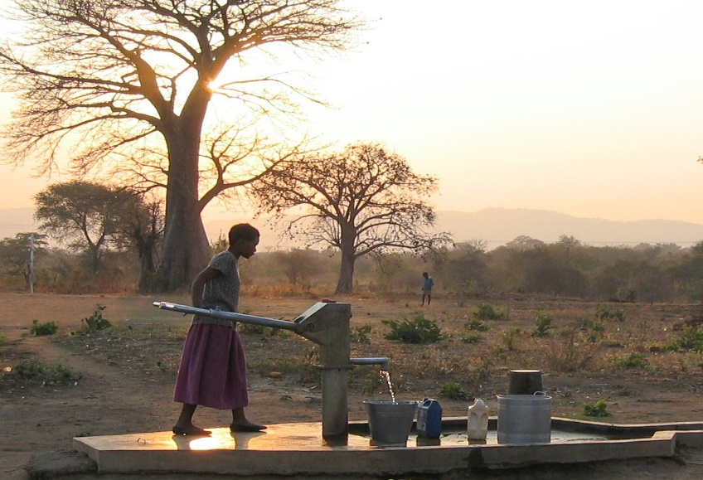
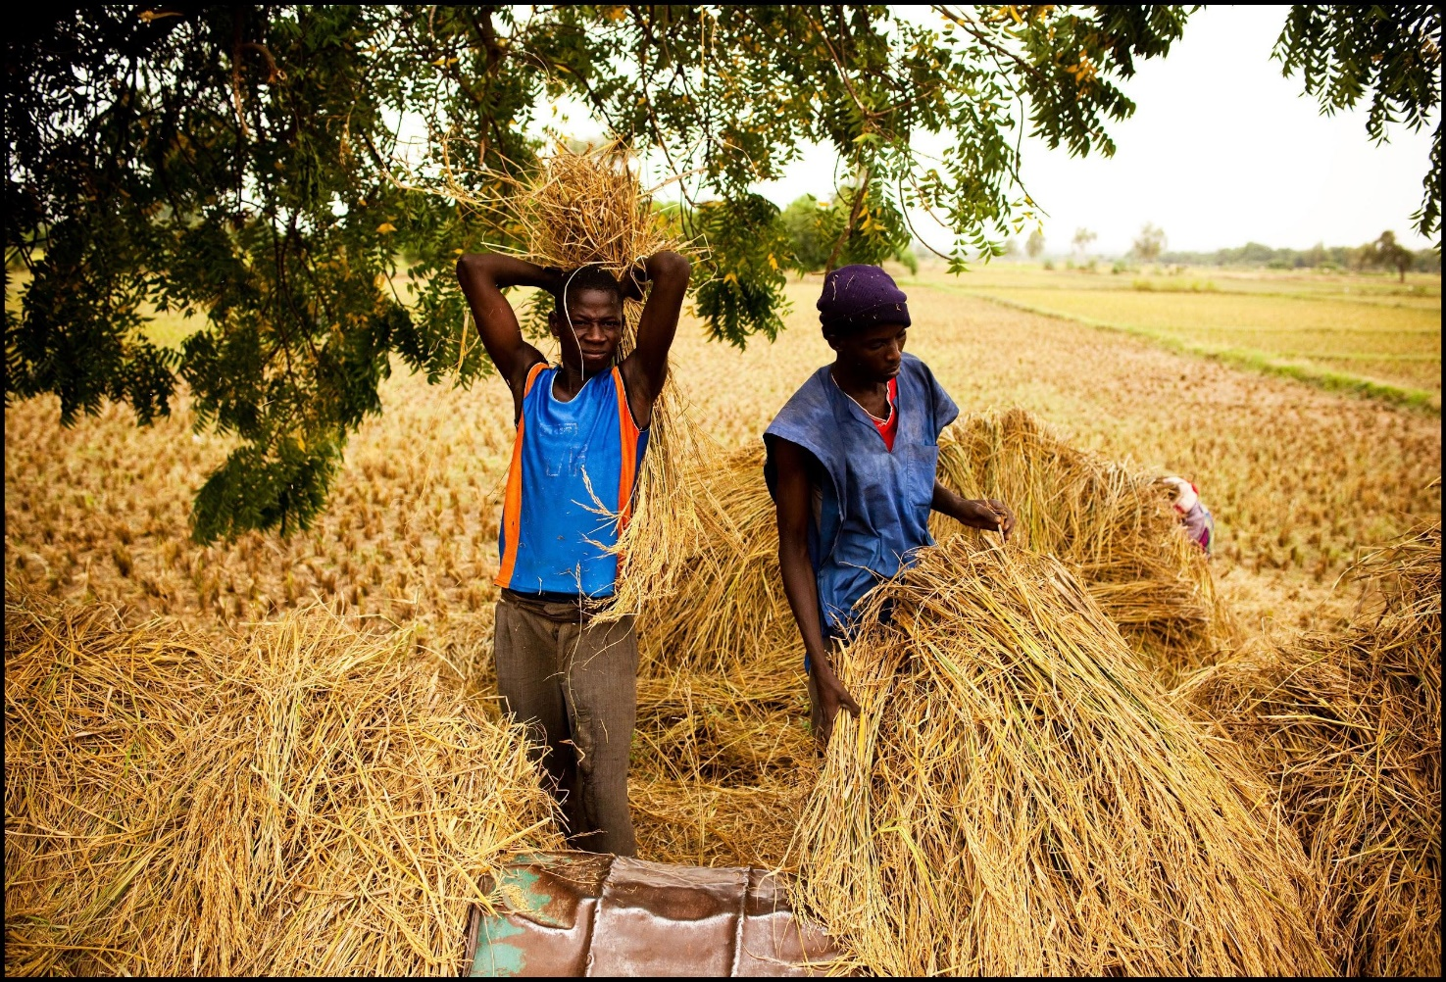
Food and water-borne diseases
Photo: K. Falk/Danish Red Cross
Photo: J. Goldstein/IFRC
Notes:
Interaction: can you think of a water and food borne disease that is climate sensitive?
Key talking points:
Food and water-borne diseases through ingestion of contaminated food or water or through contact with eyes, ears, or open wounds.
Climate change may allow for better growth, survival, transmission or virulence of pathogens.
Climate change can also lead to flooding/ droughts that can trigger food and water contamination by distruption and/or physical damage to infrastructure.
Reduced water flows especialy in droughts- can increase the concentration of pathogens and pollutants affecting water quality and safety. It can also cause water stagnation and potentially create breeding sites for mosquitoes.
In food systems particularly in processing, transport and storage- higher temperatures can facilitate the development of enteric viruses which can cause diarrhoeal diseases.
There has been great progress in reducing death rates from diarrheal diseases since the 1990s. However, this trend could be reversed in regions with increased vulnerability to contaminated water

Slide 15
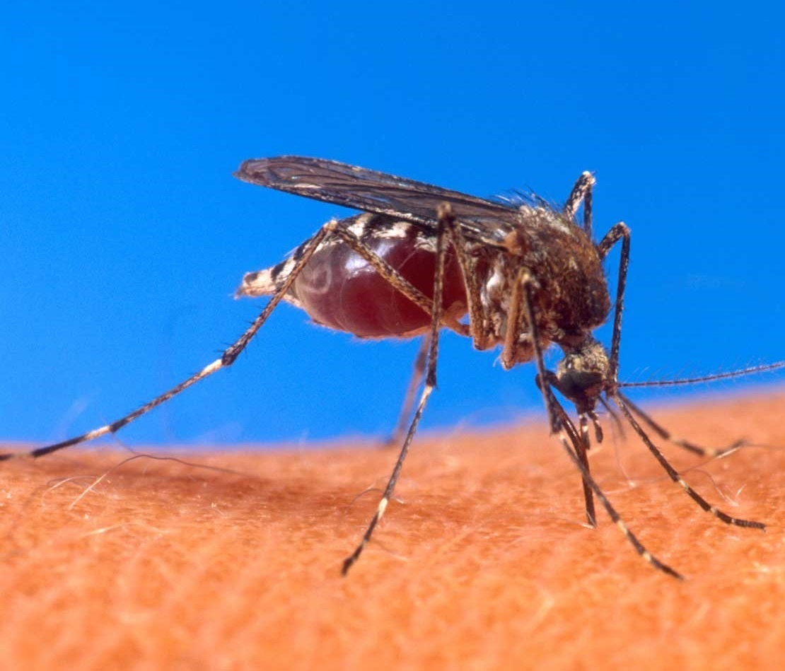
Vector-borne diseases
Mosquitoes
Develop faster
Fly further
Survive longer
Bite more
Photo: USDA
Notes:
Interaction: Can you think of a vector borne disease that is climate sensitive? Have you observed changes in vector borne disease transmission in your localities/regions/countries? Which disease? How have these changed? Over what time? (Ex: vector borne malaria, dengue, Zika, Chikungunya, Lyme, yellow fever, etc.)
- Infections transmitted by insect vectors are strongly affected by climate sentitive weather parameters conditions such as temperature, rainfall and humidity. These diseases include some of the most important current killers: malaria, dengue fever and yellow fever.
- Climate change may change the temporal and spatial patterns of many vector-borne diseases. This means that the geographical areas where vector borne diseases occur are expanding, as new areas become suitable for mosquito development.
- An increase in temperature can affect mosquito development. This is particularly worrisome because the populations that are newly exposed to an infectious disease may lack immunity to that disease which could result in larger and/or more severe outbreaks.
- An increase in temperature can increase vector development and behaviour: mosquitoes could develop faster, fly further, survive longer and bite more. High temperatures can also increase mosquito mortality as mosquitoes live shorter times at significantly higher temperatures. However, the vast majority of those changes allow mosquitoes to be more effective vectors.
Interaction: Any guesses on which vector-borne disease will be most affected by climate change?
- "Malaria seems likely to be the vector-borne disease most sensitive to long-term climate change as increased rainfall, humidity and temperature can enhance mosquito breeding and survival" (WHO).

Slide 16
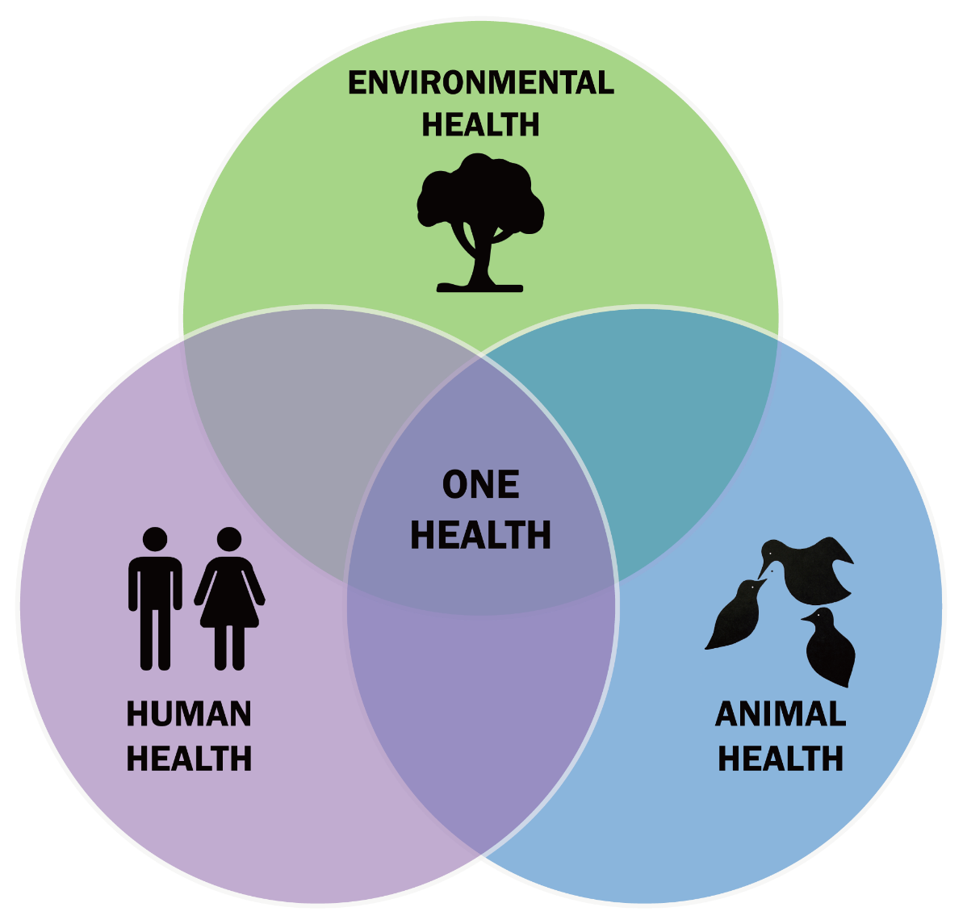
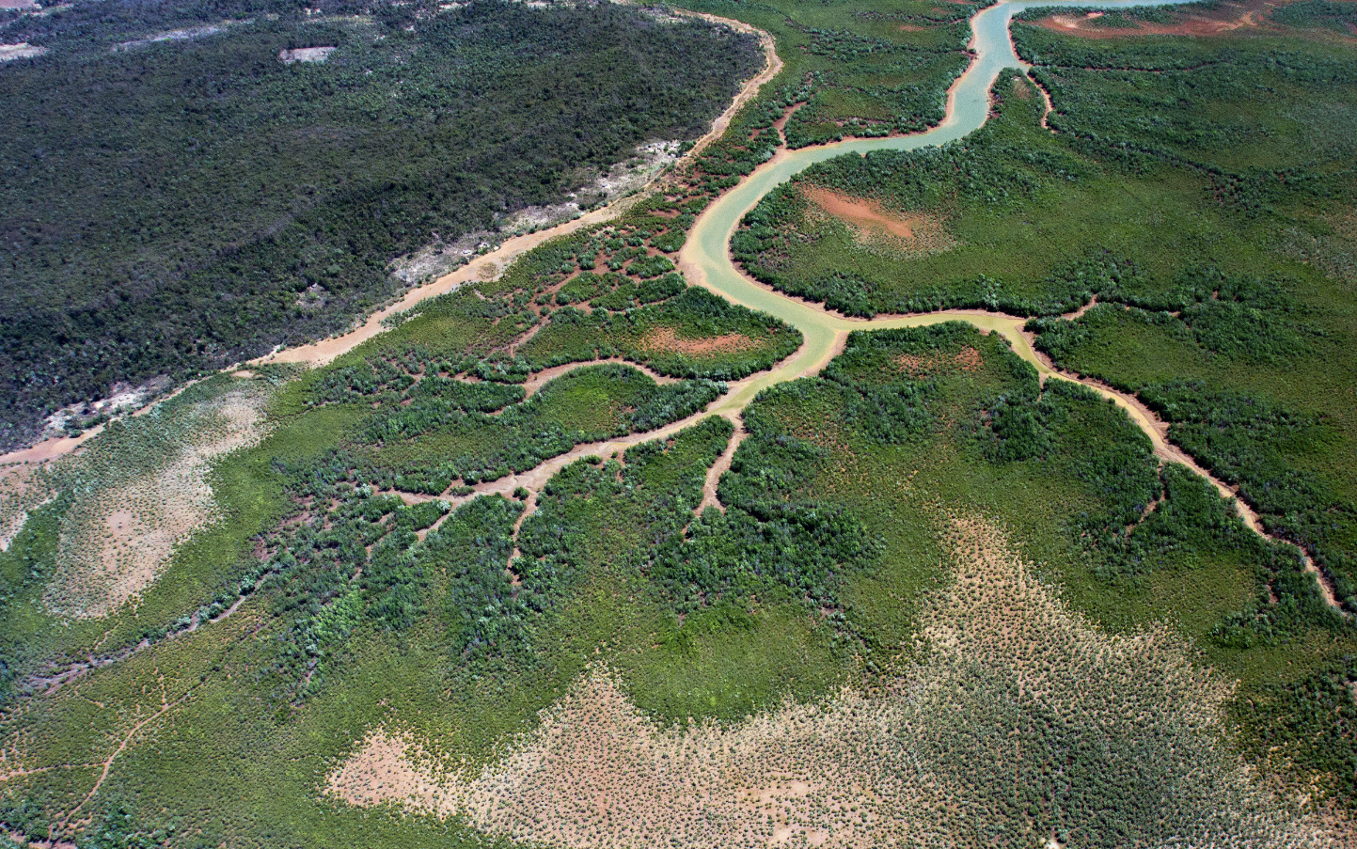
Emerging Infections - One Health
Photo: One Earth
By Thddbfk - Own work, CC BY-SA 4.0
Notes:
Interaction: Does anyone has an idea about why ecosystems are important to human health?
Key talking points:
Healthy ecosystems are the basis for healthy livelihoods and living - but ecosystems are threatened by a wide range of man-made activities such as deforestation, wetland reclamation, large-scale mining, industrialised farming, overfishing etc. Climate change is an aggravating factor, for example in destruction of coral reefs.
Ecosystem can be defined as “a geographic area where plants, animals, and other organisms, as well as weather and landscapes, work together to form a bubble of life” (National Geographic).
They provide not only a habitat for plants and animals but also provide multiple benefits and services to society - so-called “ecosystem services”. Those services include water provision and purification, food production, regulation of flows and extreme conditions…
Many activities depend on those ecosystems such as agriculture, navigation, tourism, making them essential for reaching several Sustainable Development Goals (SDGs) (WWAP/UN-Water, 2018).
Climate change and other human-related activities put a strain on those ecosystems, especially wetlands and forests. Those ecosystems are nonetheless essential for both mitigation and adaptation strategies.
The Sendai Framework for Disaster Risk Reduction, adopted by the United Nation member states in March 2015, recognized the role of ecosystem-based approaches to "build resilience and reduce disaster risk, including epidemic and displacement risk".
The “One Health” approach allows to take into account that complexity of interactions. That concept illustrates the idea that human health, animal health and environmental health are all interconnected and that we should not address one without taking into account the other 2.
Can someone think of an example for that?
Additional information for the moderator:
Water-related ecosystems such as lakes, rivers and vegetated wetlands are among the world’s most biologically diverse environments. Although they cover approximately 0.8% of the Earth’s surface, they provide a habitat for almost 10% of the world’s known species.
They also provide multiple benefits and services to society which are traditionally referred to as ecosystem services such as fish production, water provision, regulation of flows and extreme conditions, water provision and purification. Many activities depend on those ecosystems such as agriculture, navigation, tourism, making them essential for reaching several Sustainable Development Goals (SDGs) (WWAP/UN-Water, 2018).
UN-Environment / UN-Water estimates that the world has lost half of its natural wetlands in the last 100 years. While healthy wetlands function as carbon sinks, mitigating climate change, degraded wetlands are a significant source of greenhouse gas emissions.

Slide 17
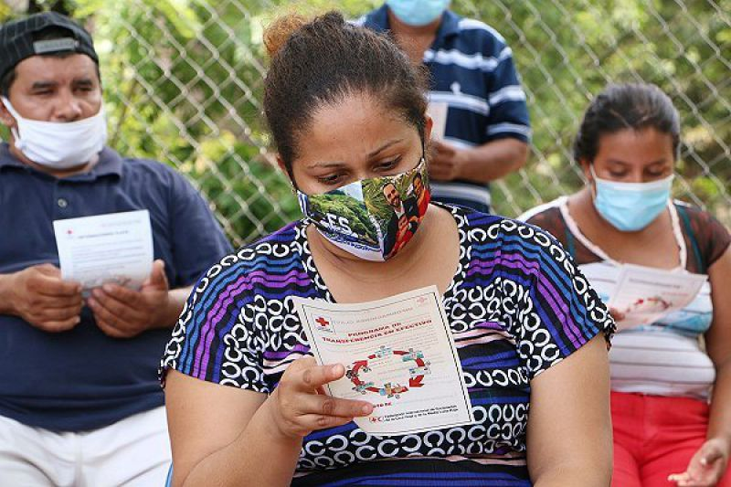
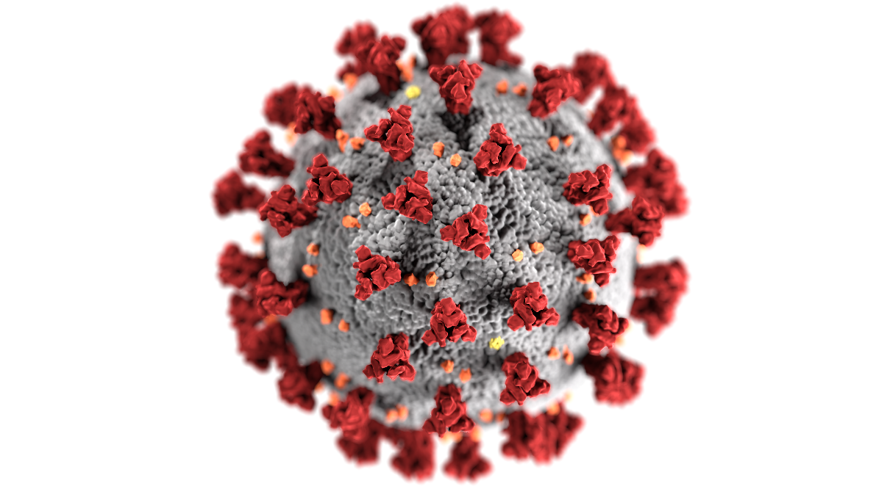
COVID-19
Photo: Centers for Disease Control and Prevention
Photo: IFRC
Notes:
Key talking points:
There are no established links between climate change and the emergence of the SARS COV2 virus.
However, it is an illustration of the complex interactions between humans, animals and the environment: The combination of changing landscape (such as deforestation) and interactions between humans & the environment and animals (such as intensive agriculture and marketing of wildlife products) and population growth has increased the risk of “spillover events”, where a pathogen is transferred from one species to another - which is what triggered the current COVID-19 pandemic.
>70%: of emerging diseases (e.g. Ebola, Zika, Nipah encephalitis) caused by microbes found in animals (i.e. are classed as zoonotic pathogens) which 'spill over' due to contact among wildlife, livestock, and people.
Just like climate change, the COVID-19 pandemic is a “vulnerability accelerator”: low-income communities, minorities, people with pre-existing health conditions… are disproportionately affected.
This pandemic also illustrates that we need to be better prepared to prevent and respond to overlapping disasters: over 430 million people in vulnerable groups have been exposed to extreme heat while facing sanitary restrictions due to the COVID-19 pandemic.
Climate/disaster and health overlaps will partly emerge while covid is happening — e.g. heatwaves, infectious and/or vector-borne disease outbreaks related to floods and droughts. When people have to crowd in emergency situations, the spread of covid is hard to prevent. So we need to adjust our contingency plans and early action protocols in light of covid-19 limitations.
The Red Cross Red Crescent Movement advocates to make sure that the recovery from the global Covid-19 pandemic leads to a “greener, more resilient society that leaves no one behind” to suport climate action!

Slide 18
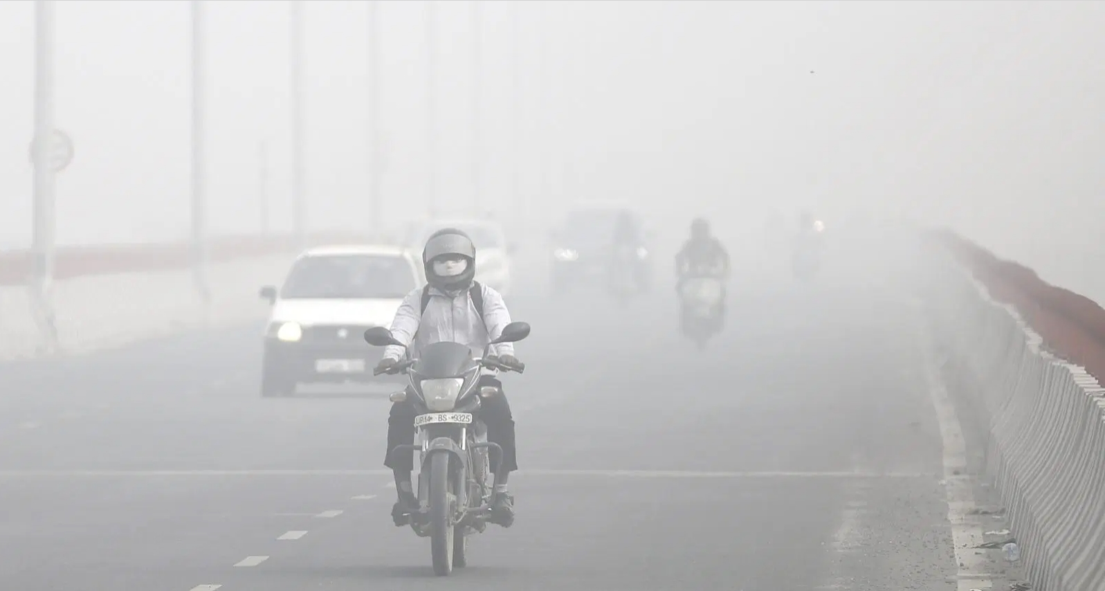
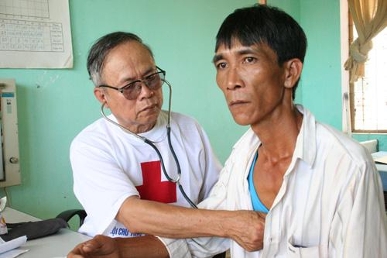
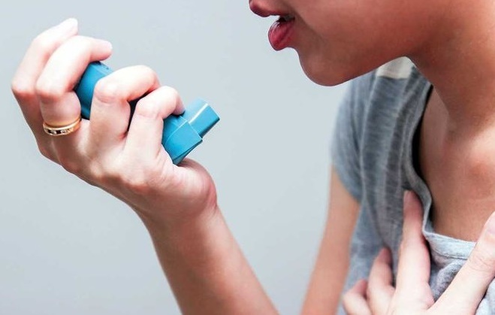
Non-communicable diseases
Photo: IFRC
Photo:AP / A. Qadri
Photo: Shutterstock
Notes:
Interaction: Do you think air pollution affects health? How?
Key talking points:
Air pollution, has been identified by WHO as "the single largest environmental health risk". Every year, 7 million people die prematurely because of indoor and outdoor air pollution.
Increase in wildfires due to climate change is expected to increase the air pollution burden in many regions.
According to WHO, NCDs constitute the largest and fastest growing global health burden. 80% of NCDs are taking place in low- and middle-income countries (LMICs).
The health impacts of air pollution depend on the particulate matter and its size (PM2.5, M10) and include mainly lung and heart diseases (ex: lung cancer, stroke, ischaemic heart diseases and chronic obstructive pulmonary disease).
Main sources of air pollution include Energy production, Agriculture, Industry and Transport amongst other sectors.
By reducing air pollution we can support reducing greenhouse gas emissions which are the main casue of global warming (known as climate mitigation).
It is also important to consider that people with underlying NCDs (diabetes, hypertension, cancers etc.) can be impacted by extreme weather events such as floods and storms that interup health services, especially amongst elderly people. Mental stress associated with disastres can exacerbate NCDs. Disasters associated temporary/seasonal forced/voluntary displacement can result in a distruption/lack of access to medication and interruption of their treatment potentially worsening it.
Latest IPCC WGII report 2022 confirms: Global air pollution-related mortality attributable to climate change is likely to increase and partially counteract any benefits achieved through emission reductions ; Exposure to wildland fires and associated smoke has increased in several regions; Climate change is projected to increase the number and severity of wildfires.

Slide 19
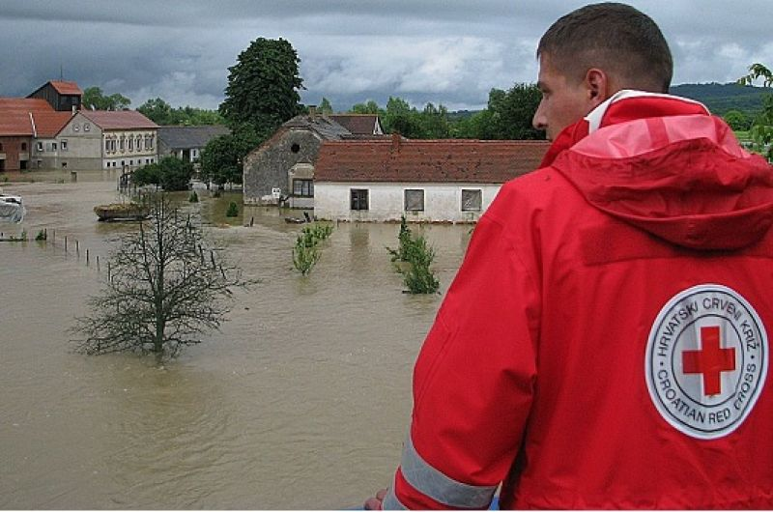
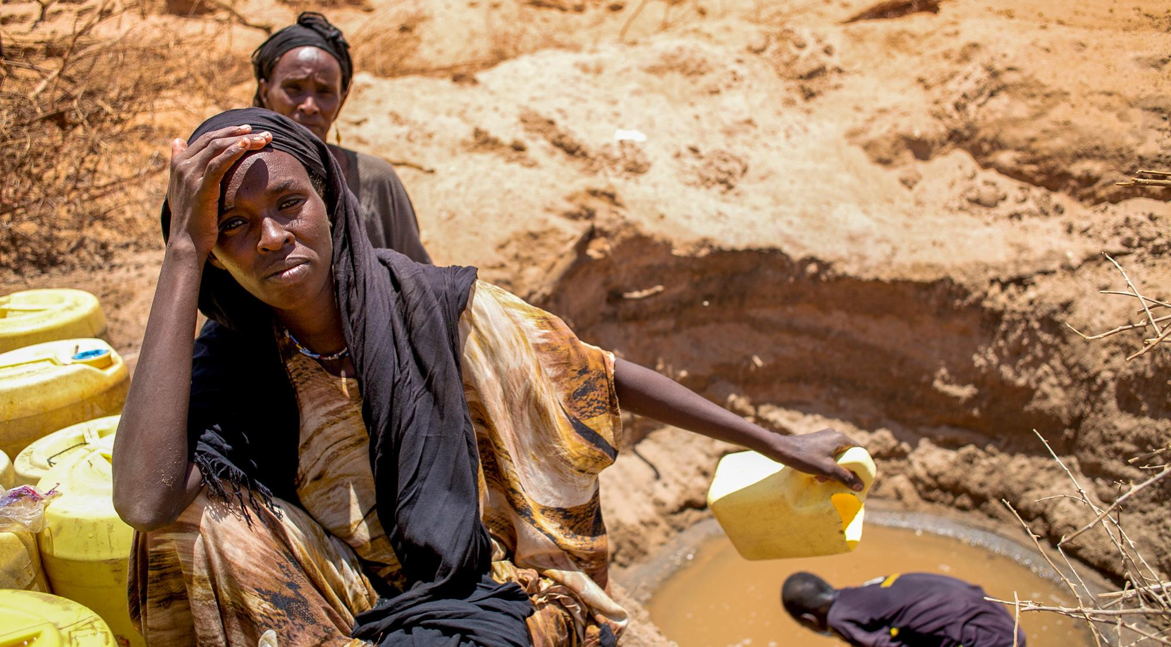
Mental Health
Photo: Croatian Red Cross
Photo: D. Onyodi/KRCS
Notes:
Interaction: Do you think climate change can influence psychological wellbeing and mental health?
Key talking points:
- Latest IPCC report in 2022 confirms: with very high confidence - that climate change is already harming physical and mental health.
- Exposure to floods, droughts and heatwaves can potentially trigger or exacerbate stress. It affects especially those people with underlying mental health conditions or high susceptibility.
Evidence suggests mental health impacts may last upto two years post disaster exposure.
Impacts include short term anxiety related conditions (e.g. post-traumatic stress) to longer-term impacts such as depression or even increased pre-disposition to suicide.
Individuals and population groups whose livelihood are subject to climate conditions (agriculture, fishing, forestry, etc.) are especially vulnerable to mental health impacts. Loss of livelihood brings other vulnerabilities through economic losses.
Climate change can cause a distressing sense of loss referred to as “solastalgia”. Solastalgia can affect people who see their environment or their land being damaged as a result of climate change.
People also experience “eco-anxiety”, which is a “pre-traumatic stress” related to the fear of environmental damage or ecological disaster. The uncertainty associated with climate change impacts makes the stress worse- particularly amongst the young.

Slide 20
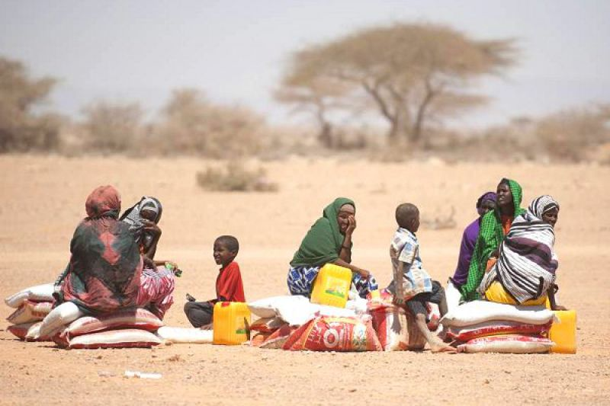
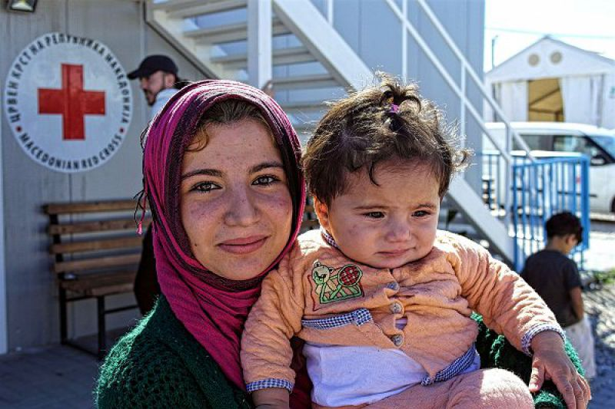
Migration (forced and voluntary)
Photo: ICRC
Photo: Caroline Haga/IFRC
Notes:
Interaction: Do you think climate change might affect migration and/or conflict? If yes, how?
Key talking points:
The current international refugee law does not recognize a “climate refugee” or “environmental refugee” status. Yet, forced migration related to climate change is already happening. The estimation cited most commonly is 200 million climate migrants by 2050, however, the number of climate migrants could range from 25 million to 1 billion (IOM).
Migration (rural to urban) is often used as a short and/or long term coping strategy for adapting to climate impacts on livelihoods. This comes with a range of additional vulnerabilities.
Migration (forced or volunatry) associated with climate change is often triggered by water and/or food scarcity, but also by extreme weather events, or sea-level rise that might make certain areas inhabitable.
“Scientists generally agree that climate change does not directly cause armed conflict, but that it may indirectly increase the risk of conflict by exacerbating existing social, economic and environmental factors” (ICRC).
Conflict and migration (forced or voluntary) have multiple impacts on population health, whether by directly causing death or injury, or indirectly by resulting in lack of access to or interruption of health services.
In addition, countries affected by armed conflict are more vulnerable to climate change impacts because of the lower adaptive capacity (people, systems, institutions) and strong survival focus on addressing the immediate/acute impacts of conflict (ICRC).
For more information please refer to the specific module on Climate Change & Displacement / Migration

Slide 21
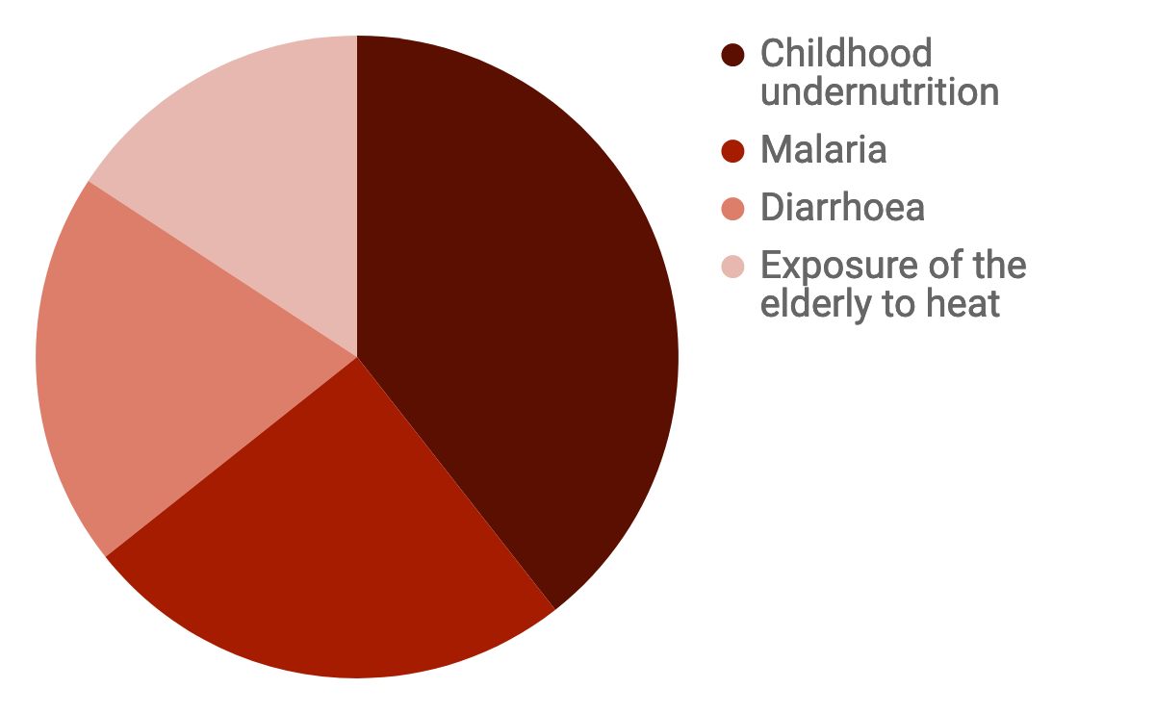
Impacts are rising and that too quite quickly
250,000 additional deaths every year after 2030-2050 (WHO)
In addition....
190 million people currently live in areas projected to be flooded because of sea-level rise by 2100
700 million people could be displaced by intense water scarcity by 2030
1.4 billion people will be without access to basic sanitation in 2050 under a business as usual scenario
Notes:
The legend of the graph will appear with animation, the purpose it to make participants guess which colour is which between the following health outcomes: exposure of the elderly to heat, malaria, childhood undernutrition and diarrhoea. How would you rank those in terms of health burden?
Interaction: based on the presentation so far, which health conditions will contribute the most to excess deaths because of climate change?
Key talking points:
One of the biggest challenge in understanding the health impacts of climate change is quantifying the impacts because of the complex underying causes and mediating factors as outlined in Slide 9/10
This last estimate is from the WHO 2014 whihc suggests that climate change will cause 250 000 additional deaths each year between 2030 and 2050. Of these: 38 000 will result from exposure of the elderly to heat, 48 000 from diarrhoea, 60 000 from malaria and 95 000 from childhood undernutrition.
These estimates only cover four outcomes and were calculated within an optimistic scenario (in terms of future socioeconomic development and adaptation). In reality it is estimated that the health of hundreds of millions more people could be affected by climate change. https://apps.who.int/iris/bitstream/handle/10665/276405/9789241514972-eng.pdf?ua=1
Further predictions expect 9.25 million deaths annually by the 2100 under a high admissions scenario or up to 24 million without adaptation and economic growth. https://www.enbel-project.eu/news-page/what-does-the-ipcc-report-tell-us-about-health-effects-of-heat-air-pollution-and-infectious-diseasesnbsp
70% of global deaths are caused by climate sensitive diseases largely concentrated in Asia and Africa. The impacts of these diseases will grow with climate change with largest impacts in vulnerable regions.
Additional information for the moderator:
190 million people currently occupy global land below projected high tide lines for 2100: https://www.nature.com/articles/s41467-019-12808-z
700 million people could be displaced by intense water scarcity by 2030: https://www.unwater.org/water-facts/scarcity/
1.4 billion people will be without access to basic sanitation in 2050 under a business as usual scenario: IPCC - Chapter 11. Human Health - Impacts Adaptation and Co-Benefits - 2014 (11.3.6. Projections for Vulnerability, OECD, 2012)

Slide 22
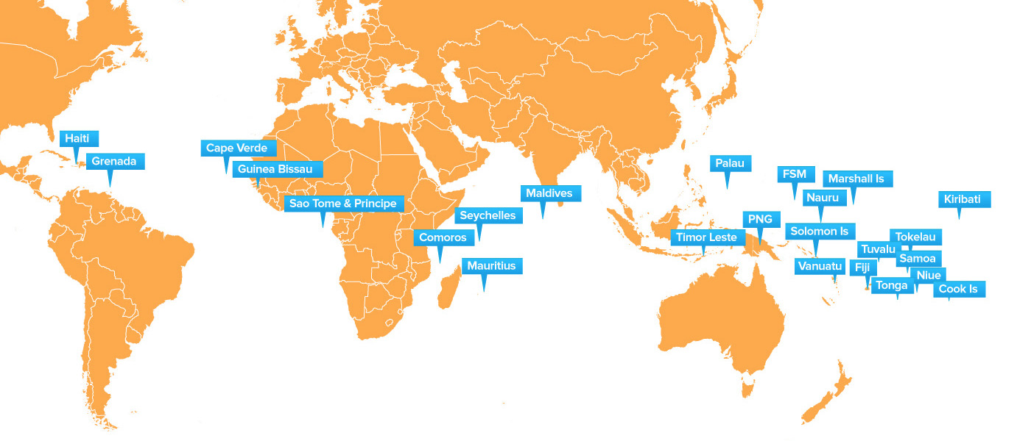
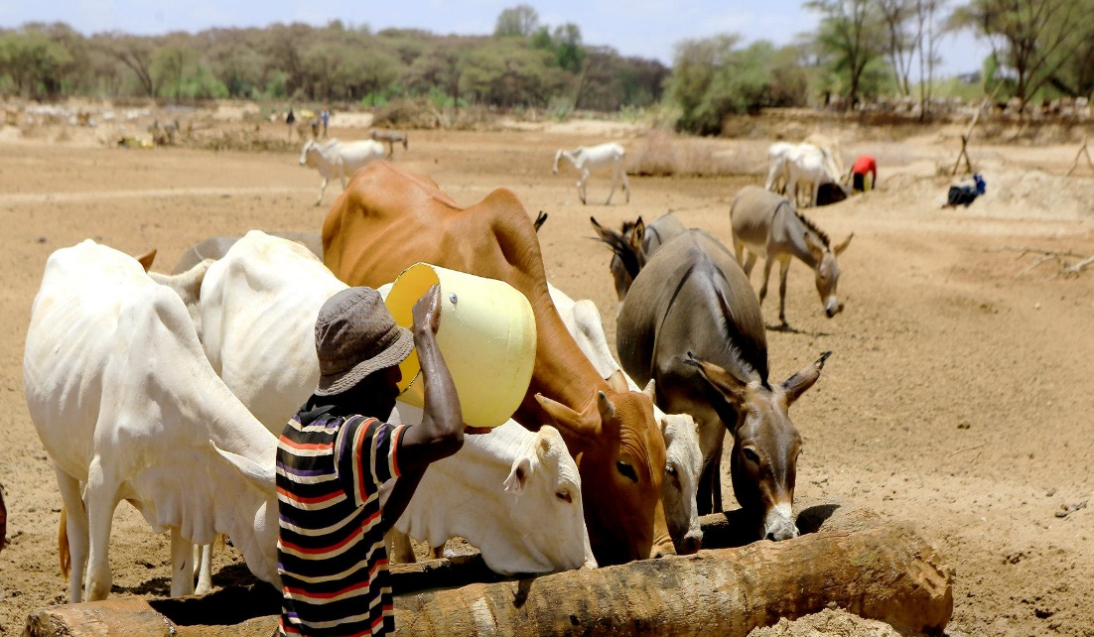
Marginalised and the poor are disproportionately affected
Photo: IFRC
Source: UNDP
Photo: D. Onyodi/KRCS
Notes:
Interaction: Can you think of populations or places that are particularly vulnerable to the health consequences of climate change?
Key talking points:
· Climate change does not affect everyone in the same way.
· Impacts depend on exposure, vulnerability and adaptive capacity
· Here are the main categories (Adapted from IPCC - Chapter 11. Human Health - Impacts Adaptation and Co-Benefits – 2014)
1-Geographic causes of vulnerability: areas vulnerable to sea-level rise and flooding, people living in citify are more susceptible to heatwave, rural populations relying on farming for subsistence are at higher risk of undernutrition and water-related diseases in case of drought.
2-Age, gender, current health status: Children and older adults are at higher risk of climate-related injuries and diseases (ex: elderly people are vulnerable to heatwaves or floods, children are more susceptible to diarrhoea and malnutrition). Gender disparities can vary depending on climate risks (ex: in Bangladesh, women were found to die during a flood, but in China, men were found to be more likely to die from flooding because of higher exposure through rural farming). Pre-existing health conditions such as diabetes, high blood pressure, mental health issues etc. are also vulnerability factors in the context of climate change.
3-Socio-economic status: “the poorest countries are generally the most susceptible to damage caused by climate extremes and climate variability”, even though they are not contributing much to climate change. “In many countries, race and ethnicity are powerful markers of health status and social disadvantage”. For example, indigenous people who depend heavily on natural resources are at higher risk of economic loss and poor health as a result of climate change.
4-Access to healthcare facilities and other infrastructure: people who do not have access to quality health services or to a health coverage are more likely to be negatively affected by climate change. Lack of access to safe water is also a vulnerability factor in the context of climate change.
Additional information for the moderator:
"Climate justice “insists on a shift from a discourse on greenhouse gases and melting ice caps into a civil rights movement with the people and communities most vulnerable to climate impacts at its heart,” said Mary Robinson who is no stranger in the world of politics and human rights" (Source: un.org)
"While many developing countries emphasize the historical responsibility of the developed world when it comes to GHG emissions, many developed countries have remained reluctant to bear the full burden of climate responsibilities. From this, the concept of climate justice has emerged, stressing that climate change is an ethical and political issue as well as an environmental and physic alone" (Source: UN - World Water Development Report 2020 - Water & Climate Change)
Women and girls are exposed disproportionately to risks of waterborne diseases during floods due to a lack of access to safe water, the disruption of water services and increased contamination of water resources.
Image source:
UNDP: https://www.adaptation-undp.org/projects/undp-sids

Slide 23
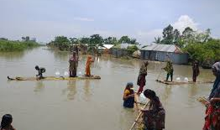
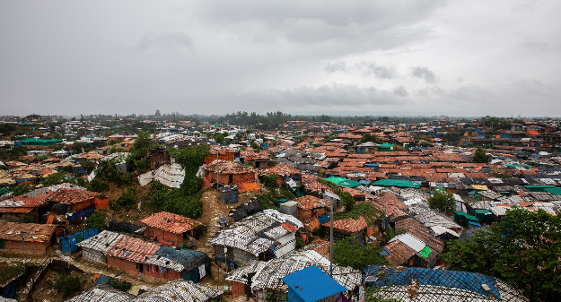
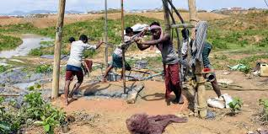
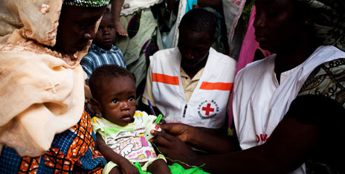
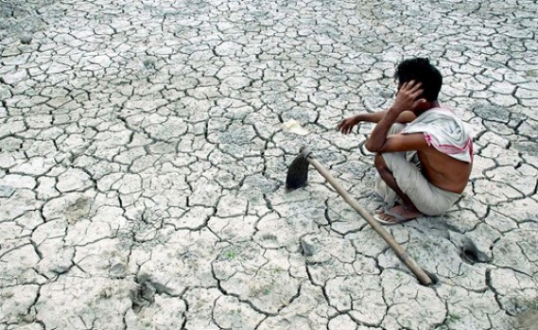
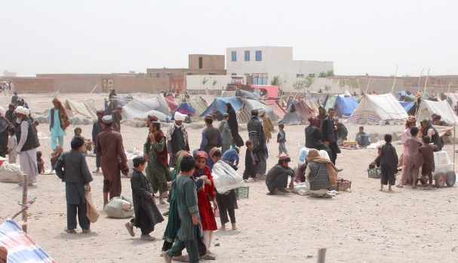
How do vulnerability factors exacerbate the negative effects of climate change on health?
Drowning, injury, death
Repeated diarrhoea
Mental health disorders, conflict, migration
Photos: IFRC
Notes:
Interaction: What are the determinants of risk? Can you give an example of how vulnerability to a health impact be reduced?
Key talking points:
"Risk is determined not only by the climate and weather events (the hazards) but also by the exposure and vulnerability to these hazards" (IPCC - Chapter 2. Determinants of Risk - Exposure and Vulnerability - 2014).
Social determinants of health are affecting the level of risk that people face: those determinants make them more or less exposed to a climate change hazard or more or less vulnerable to that hazard.
According to the WHO, “The social determinants of health (SDH) are the conditions in which people are born, grow, work, live, and age, and the wider set of forces and systems shaping the conditions of daily life”. Examples of social determinants of health include race, gender, professional, geographical location, etc.
Here are a couple of examples to illustration how a climate change-related hazard + vulnerability criteria can result in increased negative health impacts:
Example 1, direct impact of climate change: Increased frequency and severity of floods etc. + Unsafe housing = Increased risk of drowning, injury or death.
Example 2, impacts mediated through natural systems: Food and water contamination + Lack of access to food or safe water = Increased risk of repeated diarrhoea.
Example 3, impacts mediated through socio-economic systems: Water scarcity + Living in a conflict-affected area = Increased risk of conflict, migration and mental health disorders.
The examples are presented here in a schematic way, but they are actually interconnected. For example someone living in an unsafe housing might be at higher risk of death an injury in case of a natural disaster, but might also lack access to safe water and be more exposed to diarrheal risks resulting from drought or from water contamination.
Additional information for the moderator - Sources: IPCC - Chapter 2. Determinants of Risk - Exposure and Vulnerability - 2014.
"Hazard refers to the possible, future occurrence of natural or human-induced physical events that may have adverse effects on vulnerable and exposed elements". Hazard is a component of risk, it is not risk itself. It can be increase by human activities and climate change (ex: higher hazard of flooding in areas that have been deforested).
"Exposure refers to the inventory of elements in an area in which hazard events may occur". For instance the exposure is not similar if the hazard happens in a very populated city or in a desert.
"Vulnerability refers to the propensity of exposed elements such as human beings, their livelihoods, and assets to suffer adverse effects when impacted by hazard events". Some examples of vulnerability factors are listed above.

Slide 24
Part II What can we do to reduce health impacts of climate climate?
Image: Pixabay
Notes:
What do you think about as potential action to reduce health risks due to climate change?
This question could be first posed as an open question to the audience to gather their thoughts.

Slide 25
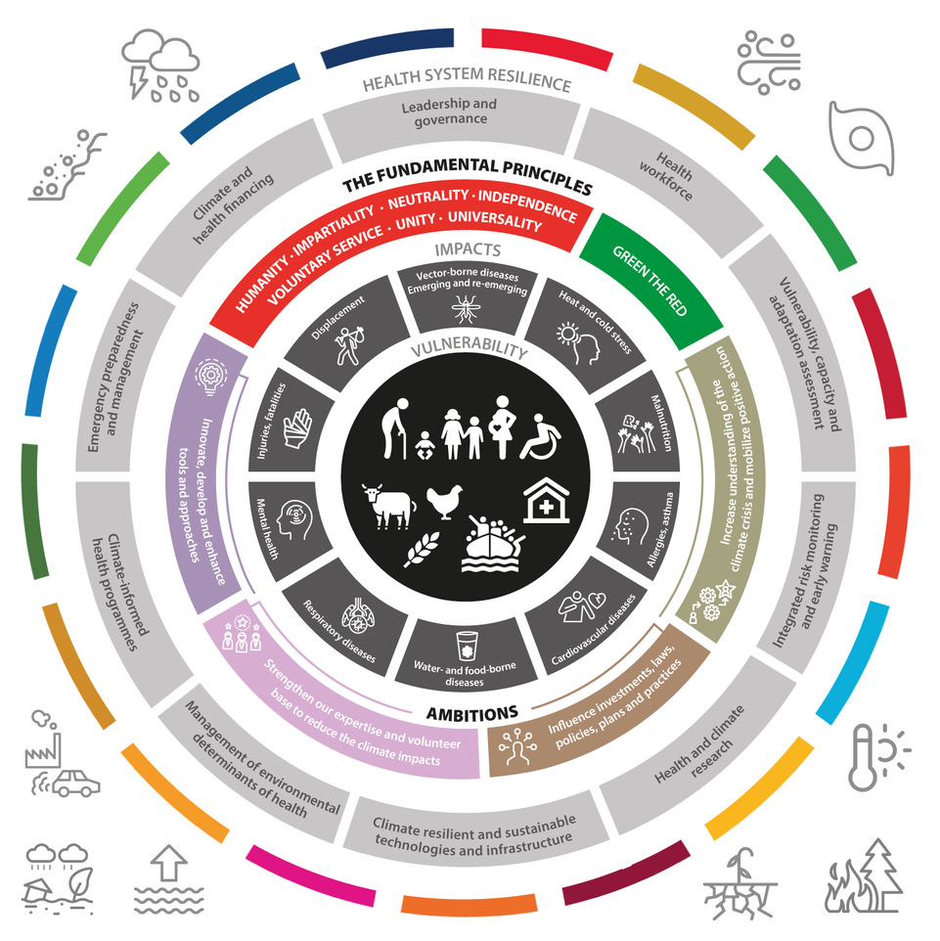
Notes:
To summarise the presentation:
Key vulnerable groups overlap and include environmental, social and human systems and affects animals, plants as well as humans alongside
Health impacts are a function of exposures and the mediating factors that exacerbate vulnerabilities or offer protection. Reducing vulnerabilities and improving adaptive capacity is key.
Recovery from disasters are key opportunities to build back better and improve resilience (ability to sense, absorb some of the impacts, recover and reduce future impacts)
IFRC is uniquely positioned to respond to climate change impacts given the large dispersed network of NS and Volunteers and strong presence in the communities before, during and after disasters.
Strengthening healthcare services to sense and flexibly respond to seasonal and long term changes to health needs of populations is key.
Climate Change is a developmental challenge affecting country progress towards achieving sustainable development goals- all planned work should take medium to long term impacts of climate change into account.

Slide 26
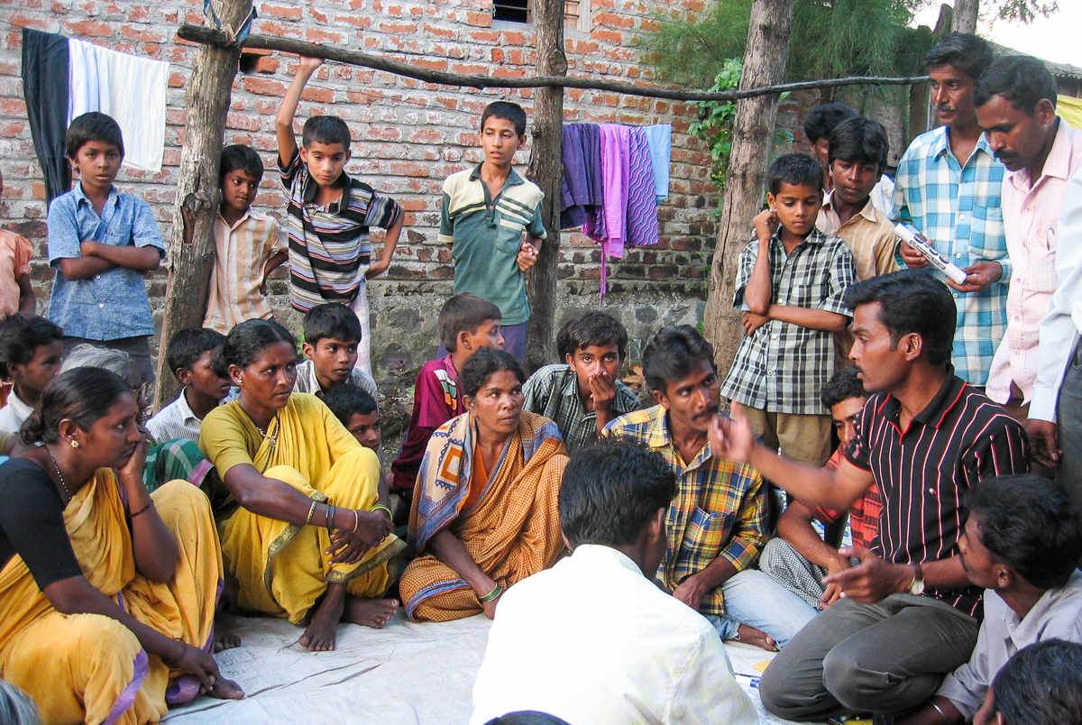
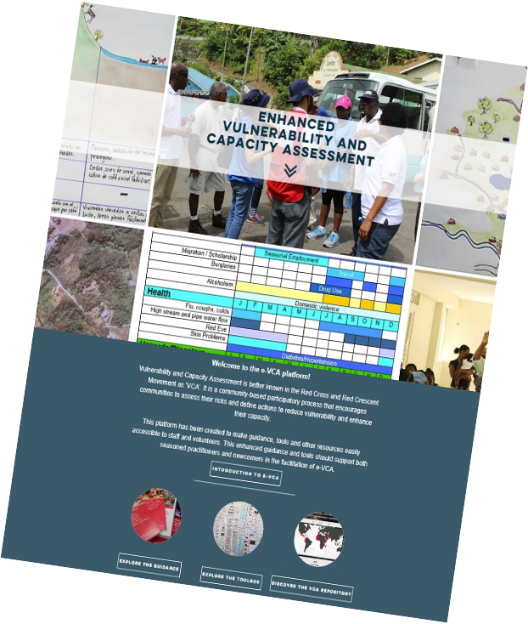
Risk assessment- the essential first step
Photo: K. Falk / Danish Red Cross
Notes:
Key talking points:
The first essential step is to conduct in depth risk assessments in order understand hazards, exposures, vulnerabilities and identify priority areas and locations for priorizing action
When doing a risk analysis it is critical to look at the intersection of the effects of this hazard with any long term change processes related to climate change.
It is also important to consider vulnerability factors that are specific to health outcomes, such as gender, age, underlying health conditions, housing conditions, geographical location, socio-economic status. That will allow the assessment to identify vulnerable populations.
It is essential to involve the community in Enhanced Vulnerability and Capacity Assessments (EVCAs). Identify “local experts” from different groups who are experiencing changing patterns (especially from marginalized groups).
Communities can also identify relevant and practical actions to reduce their risks and strengthen their resilience based on their priorities.
For more information please consult the following resources:
https://www.ifrcvca.org/
CKT Module 2a: EWEA - Steps to make it happen
CKT Module 2c: Community Resilience and Climate Presentation APR2019

Slide 27
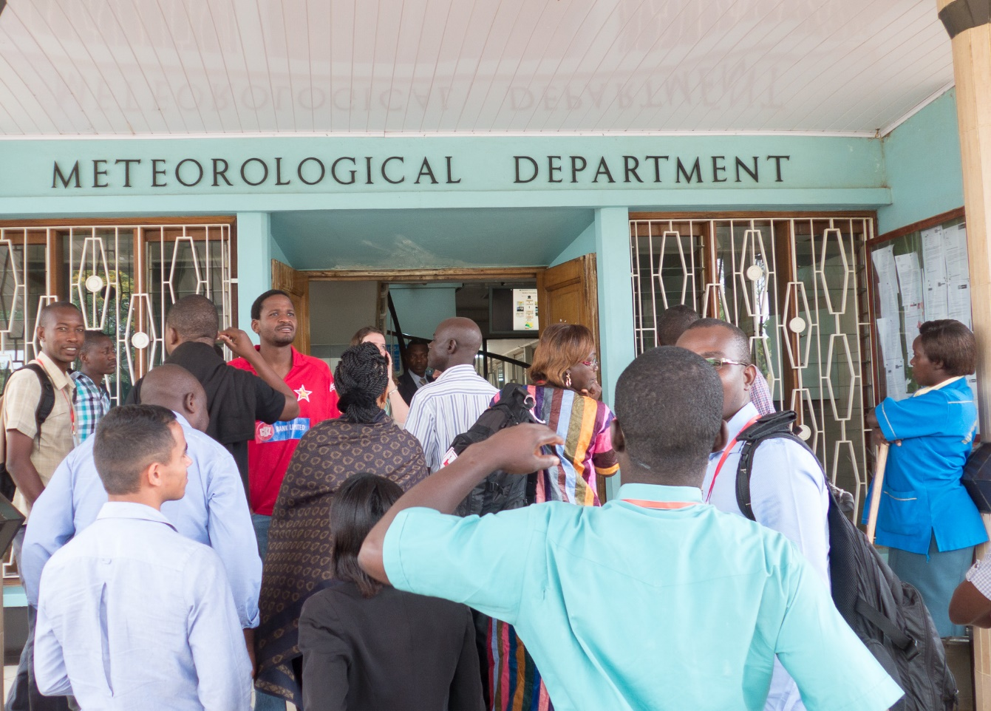
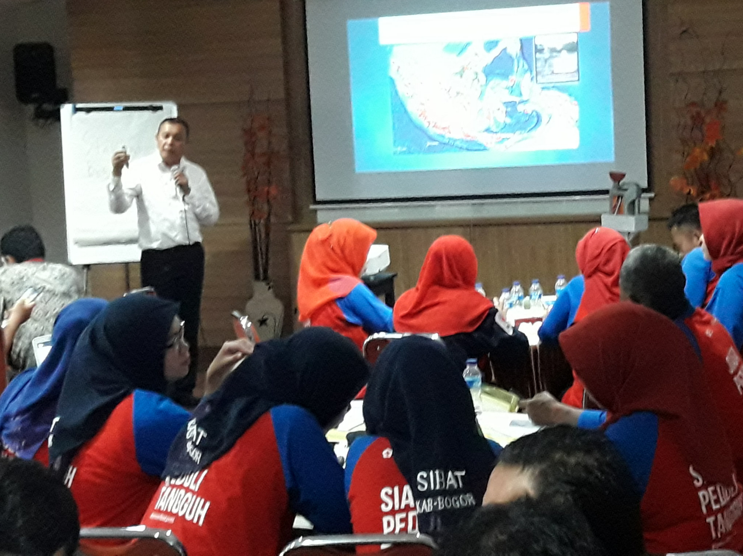
National HydroMet services and national public health authorities – our key partners
Notes:
Interaction: Is anyone in touch with the HydroMet services of their country? with the health authorities? Would you like to share your experience?
Key talking points:
In order to conduct a risk assessment it is necessary to start with whatever is currently known about changes to weather and climate and possible changes in the future:
Check if your National Society has worked on a climate change background document as part of the ‘Preparedness for Climate Change’ programme (over 60 countries had participated by the end of 2011) – this may contain useful information.
Find out if someone in your National Society is in contact with the national meteorological office and/or environment department. If not, you could make an effort to establish the relevant collaboration. In module 1 there is a guidance note on how to engage with the local weather forecasts / early warning systems / water, hydrological and climate (or “hydromet”) services. It provides good tips and hints for this dialogue and partnership development.
These offices will be able to provide an overview of historical changes (eg. rainfall patterns for a given town) that are already occurring, plus projected climate for the coming decades (eg. increasing drought for a given country). The historical trends information could be available for specific locations.
However it is important to note that projections for the future are not available accurately at local scale (downscaled models don’t agree with each other) and therefore can’t be used for guiding site selection or to help identify site-specific adaptation measures.
Good to ask the Met office if they have specific information relevant for disease outbreak patterns in the country or any historical data on this.
The NS should also engage a dialogue with health authorities to have access to information on disease outbreak and other health consequences of climate change.
REMEMBER THIS IS AN ITERATIVE PROCESS- risks, vulnerabilities and impacts are dynamic and evolve with time!
Additional information for the moderator:
Please see "Collaborating with national climate and weather agencies: a guide to getting started"
https://www.climatecentre.org/downloads/files/1a.%20Collaboration%20with%20Met%20Agencies.pdf

Slide 28
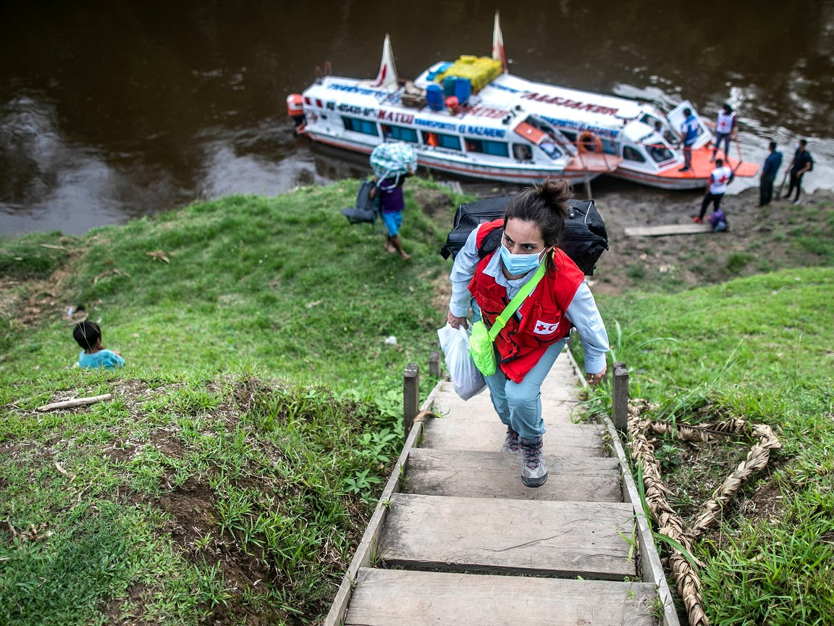
Strengthening resilience of Health Systems
Photo: The national Covid vaccination campaign for Peru’s indigenous communities in the Amazon and Andean regions, which included health education about the benefits of the vaccine. The country has also for years been at the cutting edge of anticipatory action by the Red Cross for climate-related hazards, including floods and extreme cold. (Photo: Sebastián Castañeda/ICRC-Reuters via IFRC)
Notes:
What do we mean with strengthening Health System Resilience?
Limiting the burden upon health systems to prevent and reduce the impact of climate change upon human health and strengthening health systems so it can withstand shocks and stresses aggravated by climate change to ensure continuity of (access to) health services
2. Avoiding the widening health inequities
What can NSs do to support this area of work?
This can be a open brainstorm for NSs, but we can think of:
Providing awareness raising, knowledge and skills to communities and linking community health systems to wider health system resilience building, especially via linking early warning systems and community-based surveillance.

Slide 29
Example – Heatwave action
Advocate for city heatwave plans
Join coalitions to develop institutional or urban heat wave plans
Guidelines for volunteers and first aid medical responders
Media, social media and messaging on risk reduction
Call for support to vulnerable groups (homeless, outdoor labourers, elderly etc.)
Photo: Netherlands Red Cross
Notes:
Interaction: Does your NS have a heatwave action plan in place? Have you been directly involved in heatwave action?
Key talking points:
A key role Met Office can play are in projecting anticipated extreme weather and issuing early warnings to trigget health protection advice and action
Example of Heat health warning system for high priority and vulnerable populations includes guidelines for volunteers and a sticker with key messages on ‘what to do’ when temperatures rise – most importantly:
drink sufficiently, two litres a day, even if you are not thirsty; water is best, alcohol is to be avoided;
avoid strenuous activity, in particular between 12 and 4pm (the hottest time of the day);
stay out of the heat, at least during the hottest hours, wear a hat, sunglasses and light clothes;
keep cool, for instance by putting a wet towel in your neck, taking a cool shower or bath, lowering sunshades or closing curtains in sunny rooms, closing windows when it is warmer outside than inside;
look after each other, help elderly or sick people follow this advice.
The sticker mentions a phone number for people wishing to obtain further information or advice.
Older adults and chronically ill people suffer the most during a heat wave.
What the Red Cross Red Crescent can do:
- Volunteers can visit old and sick people: Help them to drink a lot of water, help them keep cool (cold towels, put the fan on), see how they are – take them to hospital if needed
- Include heatwave risks in preparatory planning and First Aid activities at large events like marathons, fairs, concerts, etc.
- Educate people in the community about what to do in a heatwave: keep your home cool, keep out of heat, keep the body cool and hydrated, help others
Additional information for the moderator – Case study about the Heatwave action place in the Netherlands.
Until 2006, the Netherlands did not have a heat wave plan. During a 2006 heat wave in Western Europe, 1,000 more people than normal died in the country, one of the most lethal disasters worldwide of that year. The Netherlands Red Cross had already in 2005 approached the health ministry to develop a heatwave plan. The disaster of 2006 accelerated this process and with 80 different organizations in different sectors, the preparation of a heatwave plan was set in motion and agreed in 2007.
The plan resulted from good cooperation between the Ministry of Health, the National Institute for Public Health and the Environment (RIVM), the Royal Dutch Meteorological Office (KNMI), the Netherlands Association of Community Health Services (GGD) and the Netherlands Red Cross.
It targets those people who are most vulnerable to extreme heat and describes the tasks and roles of different parties involved, such as health services, general practitioners, nursing homes and volunteer organizations.
Proper warnings, early action and improved care for the elderly can lead to more effective heatwave response, as shown by French Red Cross.

Slide 30
Surveillance is critical to monitoring evolving risks and changes in the impacts
Photo: IFRC
Photo: Sierra Leone Red Cross Society
Notes:
Key talking points:
The consequences of climate change affect the distribution of epidemics, but do not fundamentally alter their characteristics
The role of communities in preventing, detecting and responding to local health threats is critical. Community- based surveillance (CBS) can effectively alert authorities on the detection of a disease outbreak within a community as well as give a voice to communities. This channel of communication enables an early detection and response to potential epidemics, making it possible to stop them before they start
The Red Cross / Red Crescent Movement is uniquely placed to implement CBS in collaboration with local Ministries of Health and partners to ensure the early detection of public health threats, and to taking pre-emptive action before the situation worsens.
Here are some good practices identified for CBS by the French Red Cross in its guide on “Taking care of humankind at +2”
Adopt a multidisciplinary and multisectorial approach in order to consider humans, animals and ecosystems as a whole. This is referred to as the “One Health” approach.
Build community resilience through a participatory approach: train and endow populations with capacities for monitoring,early warning and response, promotion of good practices, in order to better contribute to health systems.
Develop research and use science to better understand climate change and its direct and indirect effects on health and propose appropriate responses.
Text based on:
French RC - Taking care of humankind at +2
https://media.ifrc.org/ifrc/document/community-based-surveillance-guiding-principles/

Slide 31
Surveilance to always be followed by Action Early Warning, Early Action & Early Detection, Early Action
Anticipate, reduce and prepare for changing risks
Effective early warning, enables early action
Early action reduces human loss and suffering, and economic losses
Early action can protect development gains
Photo: IFCR
Notes:
There are many reasons to undertake EWEA, key ones are highlighted in this slide.
Climate and weather information can help anticipate, reduce and prepare for changing risks. It important to note that climate-related changes are different from from weather-related changes: changing vector patterns are not just related to storms, but may be a permanent new feature (ex: malaria-carrying mosquitos moving into higher altitude communities that weren't previously exposed). Health promotion needs to take into account predicted health risks for early identification and early action, not just the current health risks.
Having effective early warnings, enables early action.
Taking early action can reduce human suffering and economic losses.
Taking early action can protect development gains through reducing the impact of hazardous events.
Additional information for the moderator:
For further information, please consult Module 2a: “EWEA - steps to make it happen”; “EWEA in the Red Cross Red Crescent - Introduction”

Slide 32
Example –
early detection, early action for infectious diseases
Early Warning Systems of potential outbreaks are already being created in partnership with the scientific community on, e.g.
Malaria
Meningitis
Rift Valley fever
Diarrhoeal diseases
Notes:
Better surveillance, preparedness Early Detection, Early Action
It is essential to have a good surveillance system to detect and address the changing disease patterns, and use it to guide preventive interventions.
A maproom for Malaria Early Warning Systems (MEWS): https://iridl.ldeo.columbia.edu/maproom/Health/Regional/Africa/Malaria/System.html
For more information about early warning early action and FbF in the RC, please see:
- Climate Training Kit 2a
- https://www.forecast-based-financing.org

Slide 33
Forecast-based financing is key to improving adaptive capacity and strengthening resilience
A mechanism that enable access to funding for early action based on credible forecast and in-depth risk analysis
Photo: D. Onyodi / URCS
Notes:
FbF in the RCRC emerged in recent years as a response to the lack of action before disasters, bearing in mind that there are tools that can allow decision makers and disaster risk managements to do something to minimize risks and prepare for effective response.
The first attempt to allocate funds based on a Forecast was in 2008 in West Africa, based on a seasonal forecast. Since then the Red Cross Red Crescent has developed further the FbF approach.
Having established an Anticipatory Fund that all National Societies can have access to when they have FbF Early Action Protocols and having develop the expertise to established those protocols.
In the next slide the facilitator will find an explanation about “what Early Action is in the context of FbF” and What does it mean to be able to access funding based on forecast and risk analysis”
A Forecast based financing systems address extreme events.
Additional information for the moderator:
For further information, please consult Module 2a: “Forecast based financing - Basic”; “2a Forecast based Finance - Advanced”; “2a Understanding Forecasts for Early Action”

Slide 34
Key components of Forecast-based Financing
Notes:
So far, what we have noticed is that many of the actions that find their way in the Early Action Protocol are actions geared towards health promotion. Especially for flood early action, the EAP often contains actions like: hygiene promotion, dissemination of non-food items, such as soap, jerrycans, water purification tablets. Proper engagement of health experts in the design of these EAPs can optimize our levels of preparedness.
Additional information for the moderator:
For further information, please consult Module 2a: “Forecast based financing - Basic”; “2a Forecast based Finance - Advanced”; “2a Understanding Forecasts for Early Action”

Slide 35
Climate-smart programming - the low hanging fruit
No stand-alone programming, but modifying what we already do or influencing existing systems or schemes
Strengthen peoples’ awareness and incorporate climate and weather information in health programming
Enable ‘early warning early action’, and empower people to anticipate, absorb and adapt to climate shocks and changing risks
Account for cross-cutting and cascading risks: climate change needs to be considered alongside other risks (health, environmental risks, ecosystem degradation, etc.)
Photo: K. Falk / Danish Red Cross
Notes:
Even before we conduct climate and health impacts assessments and/or design new climate specific health programs a low hanging fruit is to climate-proofing existing programs.
This equates to ‘good programming’ and development, enabling people to anticipate, absorb and adapt to climate shocks and stresses by using climate information across timescales in exixting as well as new health programs, considering landscapes and ecosystems as key areas of intervention – all in close collaboration with governments, specialists and the private sector.

Slide 36
Engagement in policy dialogues to ensure health concerns are reflected in climate change adaptation planning
Advocacy role
Photo: IFRC
Health risk management in a changing climate project in Viet Nam
Notes:
For now there is very little engagement of health experts in the NAP process. But it should be enhanced in the future + preventative work of the Red Cross as an adaptation option
Every country has 3 million USD available to draft their National Adaptation plans and the Nationally Determined Contributions (NDC). These are commitments of states to the UNFCCC Paris climate agreement. It is important for the Red Cross and Red Crescent that these Adaptation and NDC plans reflect health concerns and that they identify solutions to reduce local risks. If we do not engage in these dialogues, there is a risks that local health risks are not addressed through renewed finance for adaptation.

Slide 37
In summary, what can we do? The five-step approach
Risk-informed early action & response
Knowledge mobilization
Understand & communicate risks
Respond & recover across systems
Learn & adapt
Advocate
Anticipate & prepare
All-hazards approach
Influence adaptation plans
Build back better
Notes:
It is important that NSs seek to:
Liaise with National Met Office to understand, map and update risk profiles, monitor impacts and develop early warning systems to enhance prevention and early anticipatory action
Moblize health teams to incorporate climate information to anticipate and prepare for current and future risks
Scaling up evidence based interventions that combine disaster risk reduction, early and resilient recovery that reduces future vulnerabilities to climate change impacts on health
Share information/knowledge with national and regional partners as well as other National Societies to facilitate peer to peer learning
Engage in policy dialogues: get involved and work collaboratively with other health actors in National Adaptation Planning processes and implementation.
Engage in reducing the National Society's own climate footprint - “Green the Red” – and lead by example

Slide 38
Part III Tools and resources
Notes:
For the facilitator – when relevant please find in the following few slides a number of resources.
The first one to highlight is the heatwave guide for cities. NSs can play an important role, advocating for city heatwave plans, and supporting the implementation of several risk reduction measures.
Heatwave guide for cities: https://www.climatecentre.org/downloads/files/IFRCGeneva/RCCC%20Heatwave%20Guide%202019%20A4%20RR%20ONLINE%20copy.pdf
City heatwave guide for Red Cross Red Crescent Branches: https://climatecentre.org/downloads/files/RCCC%20Heatwave%20Guide%202019%20NS.pdf

Slide 39
Notes:
Taking care of humanity at +2 degrees - That guide was developed by the French Red Cross following a “World conference on health and climate change” organized in 2019.
Report available at https://fr.calameo.com/read/002546479d4585876e960
The guide addresses 8 key challenges and provides best practices and examples:
CHALLENGE 1: Mitigating Health Risks Related to Disasters
CHALLENGE 2: Adapting to Heatwaves in Urban Areas
CHALLENGE 3: Preventing Epidemic Risks: Community-Based Approach and Public Health
CHALLENGE 4: Addressing Mental Health and Psychosocial Support Needs
CHALLENGE 5: Addressing Food Insecurity and Malnutrition
CHALLENGE 6: Addressing the Health Challenges of Climate-Induced Population Movements
CHALLENGE 7: Preventing Health Needs Related to the Combined Effects of Conflict and Climate
CHALLENGE 8: Protecting Ecosystems to Promote Health

Slide 40
The Minimum Standards for locla climate-smart DRR provides the core principles for a National Society to adjust is programming
Notes:
https://climatecentre.org/resources-games/how-to-be-climate-smart
http://www.climatecentre.org/resources-games/how-to-be-climate-smart
The 2009 CBHFA guide is available online: https://www.ifrc.org/Global/Publications/Health/145600_Implementation%20guide%20CBHFA%20in%20action_en_LR.pdf
– but is updated with an 'eCBHFA' on this website: https://ifrc-ecbhfa.org/guides-and-tools/
Unfortunately, climate change aspects are not fully incorporated, but the general principles outlined in the 'Minimum Standards for local climate-smart DRR' also applies to community health efforts, and also included in the 'What is climate-smart programming …'

Slide 41
Notes:
WHO – Health Environments for Healthier Populations https://www.who.int/phe/publications/healthy-environments/en/
Globally, 23% of all deaths could be prevented through healthier environments. This document presents an overview of sectoral actions that can be taken by various actors to create healthier environments, including in priority settings.
Key risk areas are addressed, such as air pollution; water, sanitation and hygiene; chemical safety and radiation; and climate change.
WHO – Guidance for Climate Resilient and Environmentally Sustainable Health Care Facilities - https://www.who.int/publications/i/item/climate-resilient-and-environmentally-sustainable-health-care-facilities
The aim of this guidance is to enhance the capacity of health care facilities to protect and improve the health of their target communities in an unstable and changing climate; and to empower health care facilities to be environmentally sustainable, by optimizing the use of resources and minimizing the release of waste into the environment.

Slide 42
Dengue fever continues to get worse with no end in sight
Notes:
Cases of dengue fever have risen dramatically in the last 40 years. This is primarily caused by unplanned urbanization with increased standing water in waste areas, and by movement (global travel) of people and goods. This has spread both mosquito vectors and infections.
Zika toolkit: https://drive.google.com/open?id=0B1b032MNqXGAUEFrakJoZklCanM
Dengue – turning up the volume: https://www.ifrc.org/dengue#:~:text=The%20IFRC%20is%20turning%20up,leading%20to%20sustainable%20behavioural%20change

